Slide 1
Notes on this presentation
This is a 15-minute presentation on AI data centers and their current and potential affect on the use of fossil-fuel energy generation in the United States.
Suggested narration is included in the “notes” section.
The Omaha, Nebraska region is considered as a specific case study, but images on slides 7 and 11 could be tailored to another location of interest.
Data on slides 8 and 10 are specific to the Southwest Power Pool region (Midwest region), but they are easily generalized to trends across the United States.

Slide 2

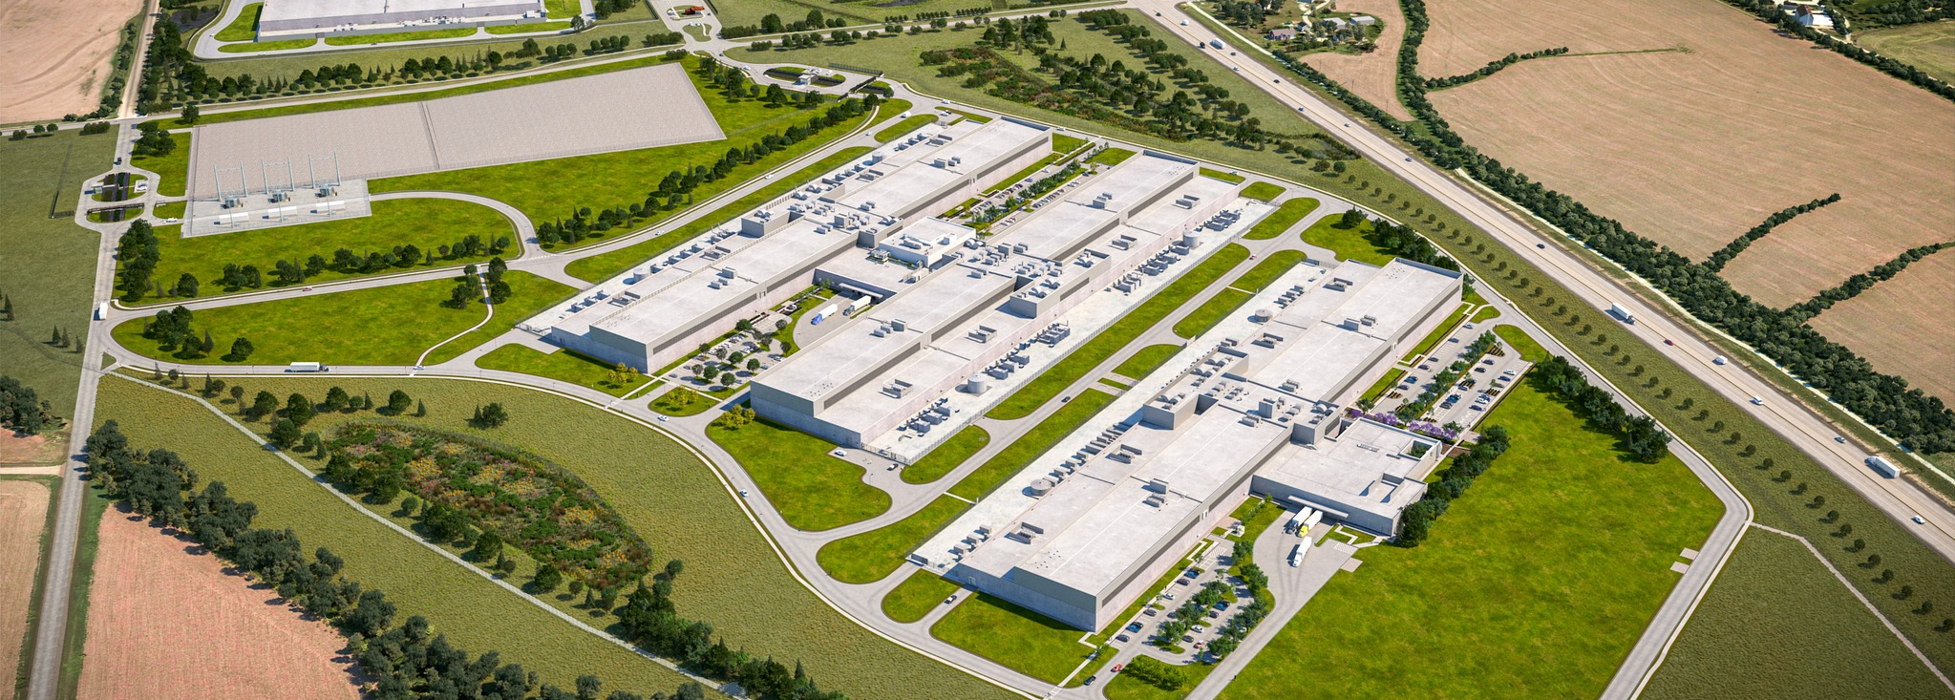

Sustainability’s
Wicked Problem
AI and Data Centers
Notes:
Narration: Any engagement with the news or social media will likely lead you to two conclusions. One - AI and Data Centers are already prolific and they are growing and two – their expansion will affect environmental sustainability. In this presentation, we’ll take that notion a step further and identify AI and Data Centers as a wicked problem in sustainability. What do we mean by a wicked problem? A wicked problem in sustainability is a complex, interconnected challenge involving environmental, social, and economic systems that is difficult to clearly define. It has no single correct solution and attempts to solve it often create new problems or shift impacts across stakeholders, places, or generations.
Image: https://nebraskaexaminer.com/2022/07/28/facebook-parent-company-meta-continues-growth-in-nebraskas-sarpy-county/

Slide 3
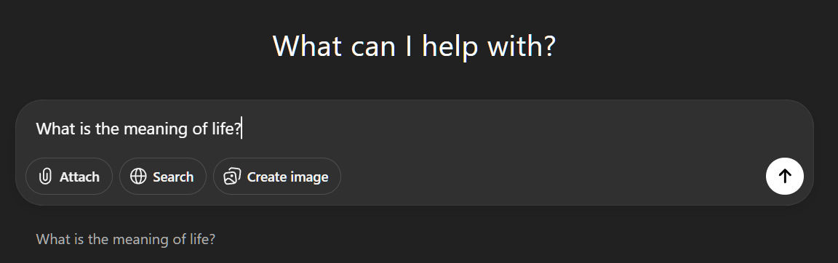
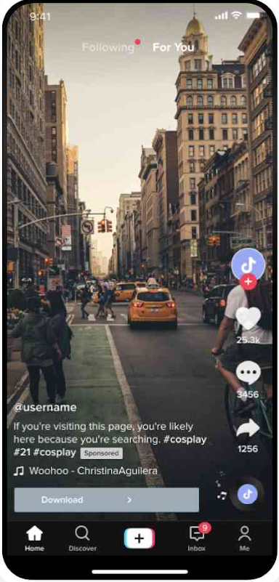

From Click to Climate
Every time you ask ChatGPT a question, get an add suggestion, build a playlist, stream a movie, or train a machine learning model for class,
something happens behind the scenes.
Image: Screenshot from OpenAI (openai.com)
Image: Screenshot from Spotify (wallpapers.com)
Image: Screenshot from TikTok (nealschaffer.com)
Notes:
Narration: Let’s do a quick level set. Every time you use ChatGPT, save something to the cloud, or train a new agent model, something is happening behind the scenes that has little to do with your personal computer or phone. These actions can feel weightless, but they immediately trigger computational processes in data centers. The more complex the engagement, the more resources that are required.
Images: Three separate screenshots of various digital tools, including ChatGPT, Spotify and TikTok

Slide 4

AI models and saved data live on servers inside data centers.
These are huge buildings packed with thousands of machines.
Image: Smart Data Centers (climawellsystem.com)
Image: Screenshot from GoogleMaps (google.com/maps)
Notes:
Narration: All of the data and all of those models live and operate on servers—industrial‑grade computers built from highly optimized chips engineered to perform enormous volumes of calculations with incredible speed and reliability. These servers are arranged inside vast data centers, stacked in racks and lined up row after row like the image on the screen, where a single building can contain thousands upon thousands of these machines all working in unison.
A single large AI model can consume megawatt‑hours of electricity and millions of gallons of water every year.

Slide 5
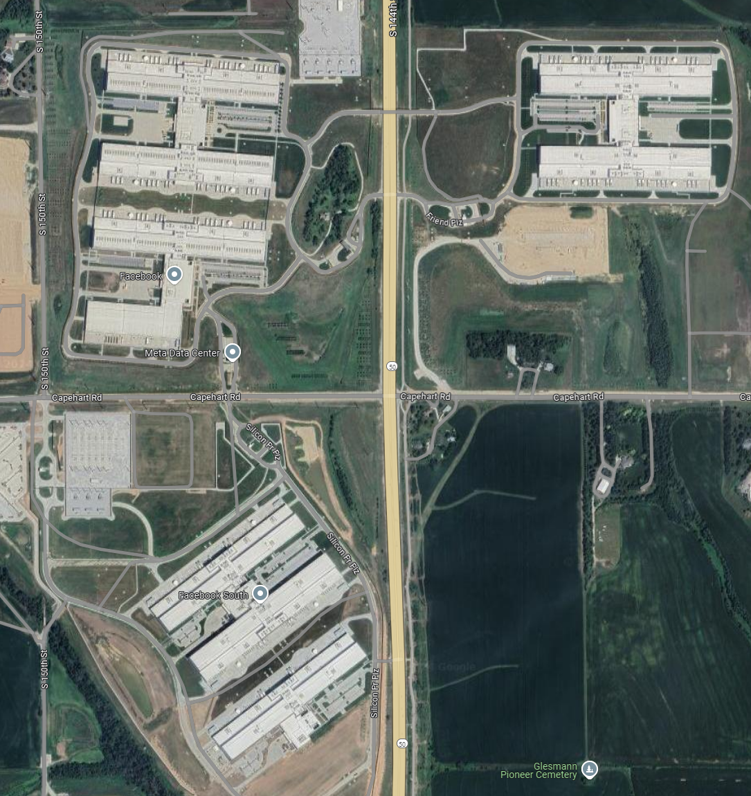
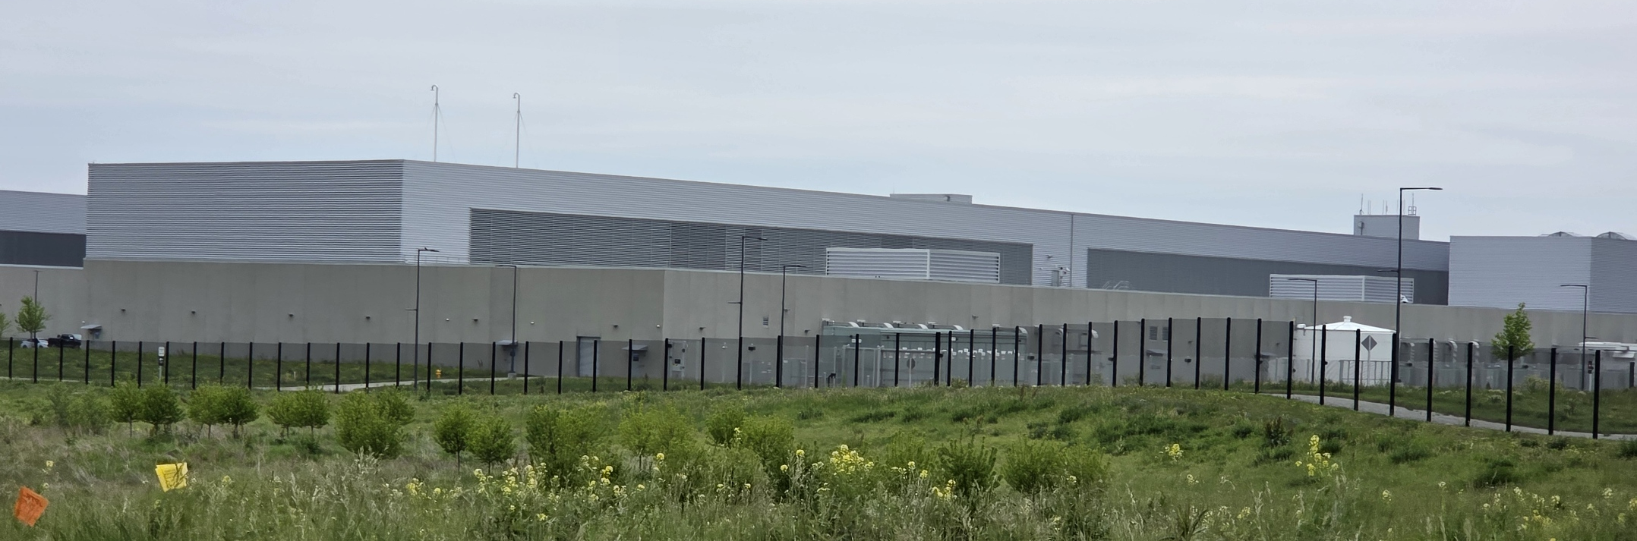
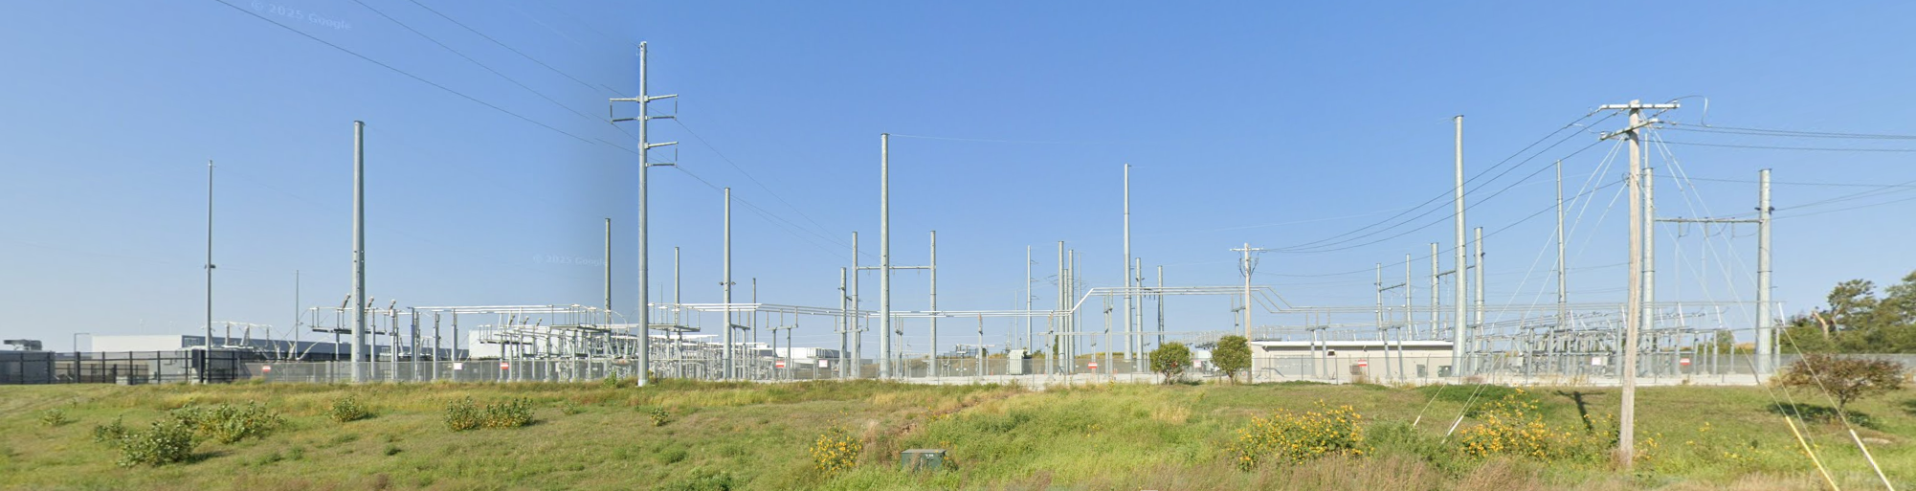
AI models and saved data live on servers inside data centers.
These are huge buildings packed with thousands of machines.
Image: Smart Data Centers (climawellsystem.com)
Image: Screenshot from GoogleMaps (google.com/maps)
Notes:
Narration: Because of the sheer scale of data involved and the immense demand for computing power, companies often require multiple data centers - sometimes several clustered at a single site.
click
Much like a graphic artist duplicating the same brushstroke again and again, AI data centers rise in identical rows, each mirroring the last. They are built in locations with reliable access to large amounts of electricity and/or cooling water - often just beyond major metropolitan areas, where energy and water costs are more competitive.
click
What stands out when you see these facilities is the extraordinary amount of power infrastructure surrounding them: widespread substations, banks of transformers, and a complicated network of high‑capacity power lines - equipment on a scale comparable to what you’d find supporting an entire city.
A primary point for this presentation is that the energy generation needed to supply these data centers, which support AI, is not always located nearby.
In fact, these data centers often pull their energy from the broader power grid, and their operation and growth influences the need for and the expansion of fossil‑fuel‑based energy sources, including coal, natural gas, and fuel oil.
Additional Note: According to the Boston Consulting Group, Due to AI, data center power consumption will grow from 2.5% of U.S. electricity to 7.5% over the next five years. And that means there is an energy shortage, with more than 12,000 active projects trying to add to the grid leading to significant power shortages in excess of 45 GW.
Image: Smart Data Centers. https://climawellsystem.com/

Slide 6
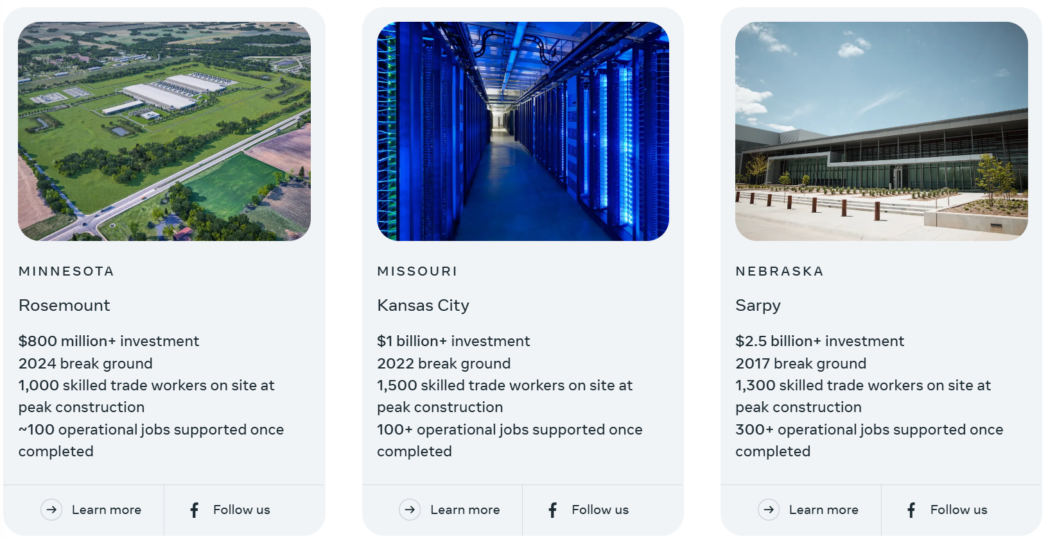
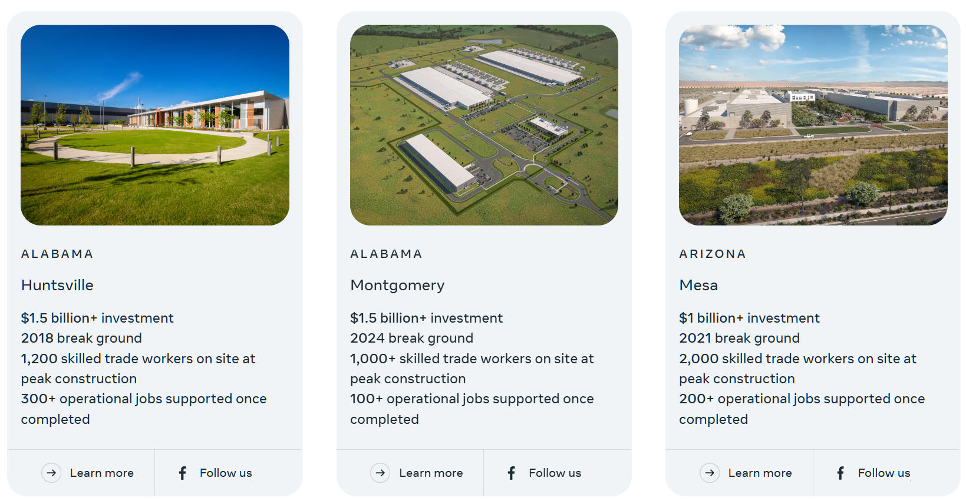
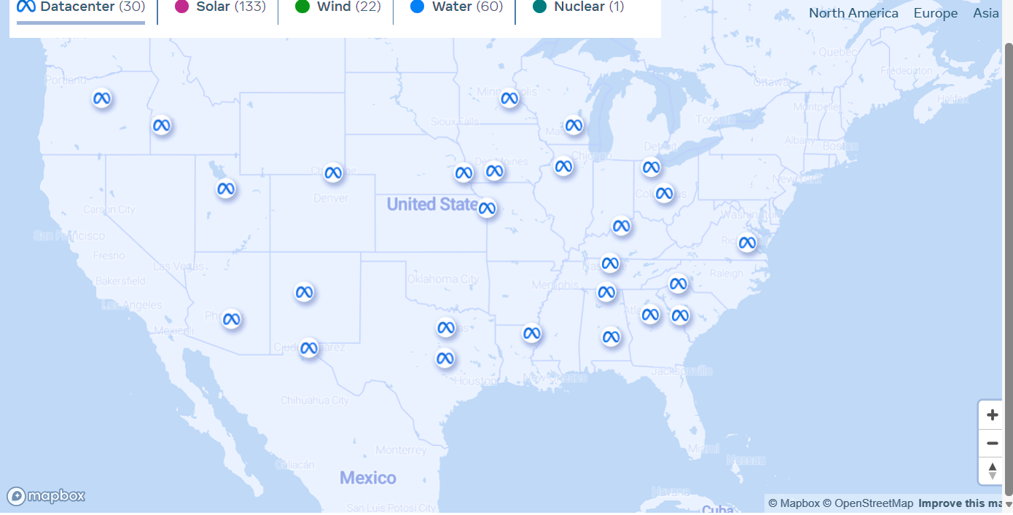
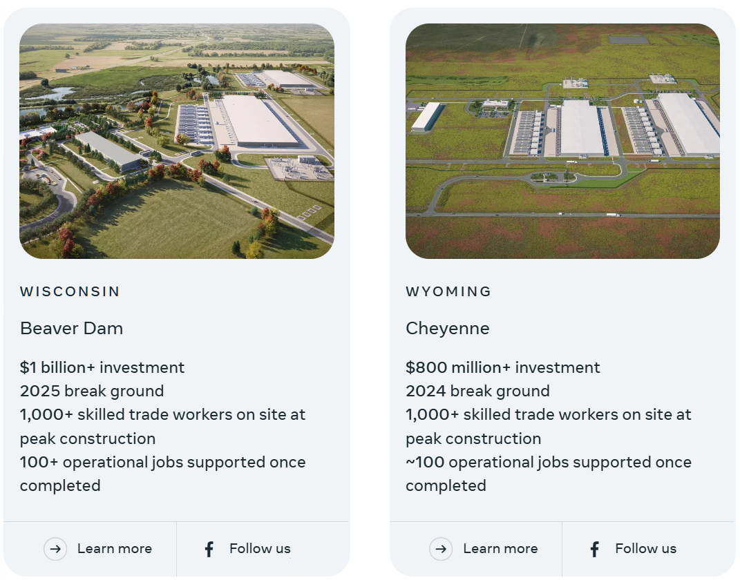
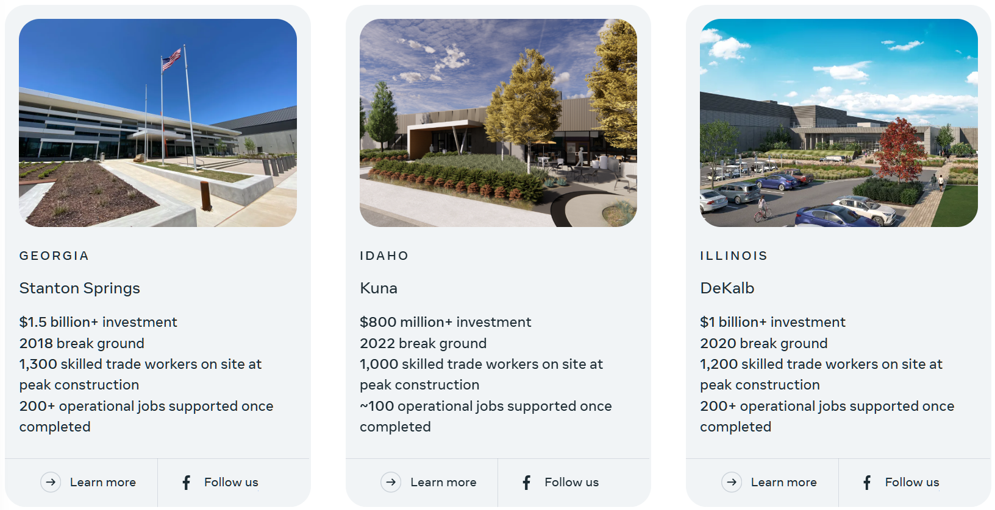
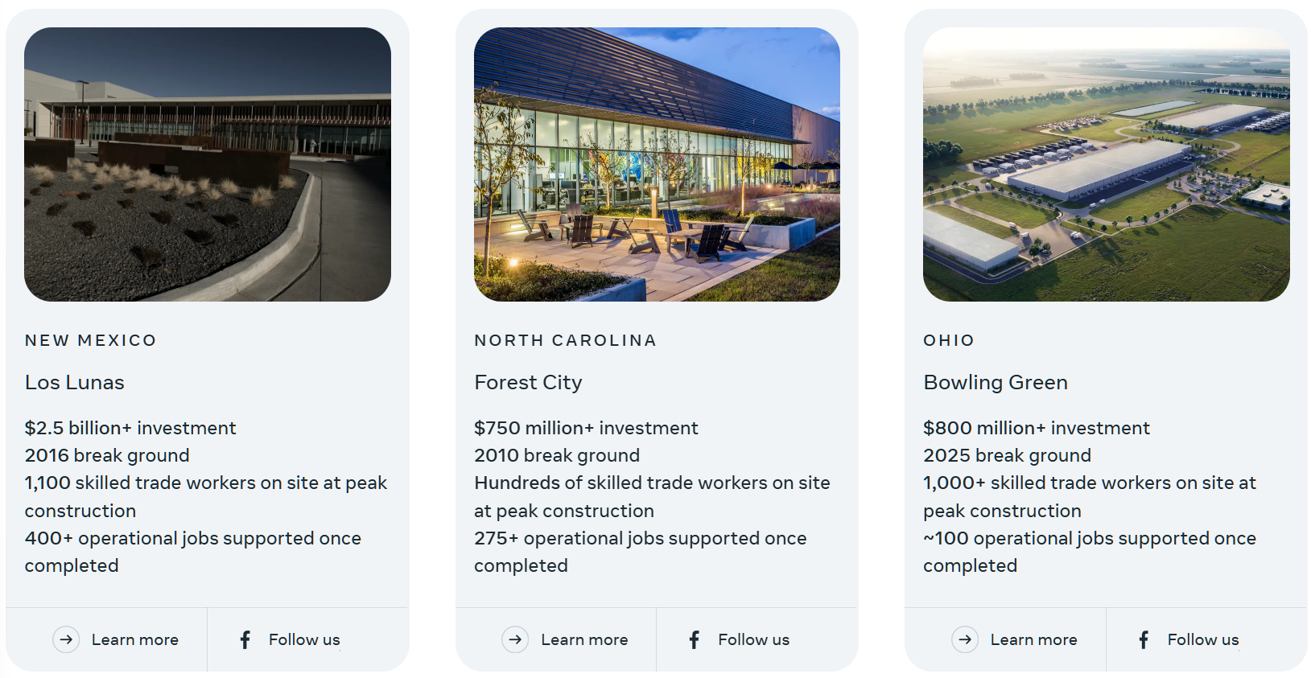
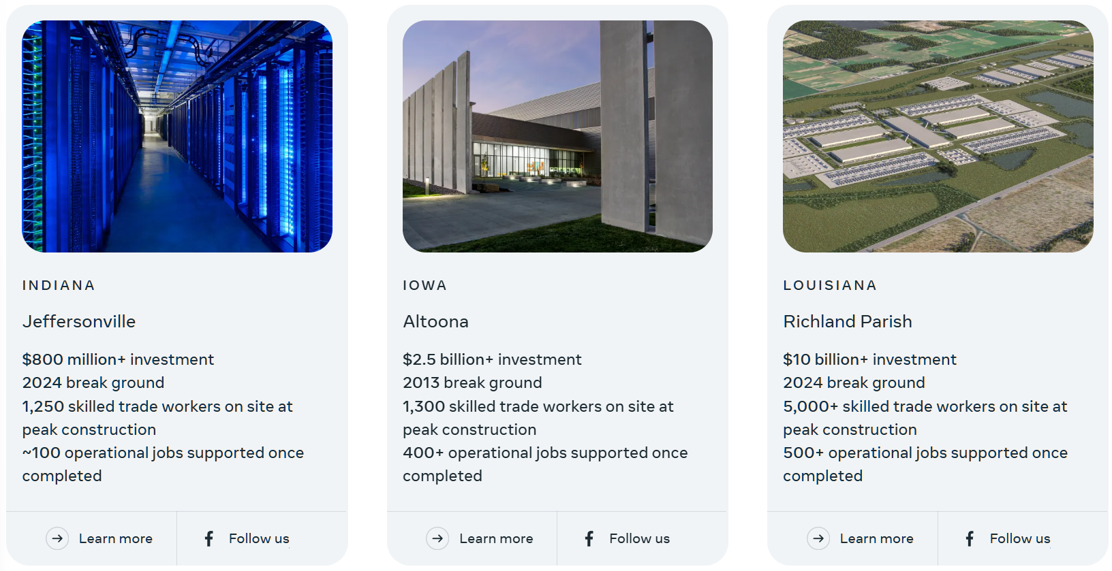
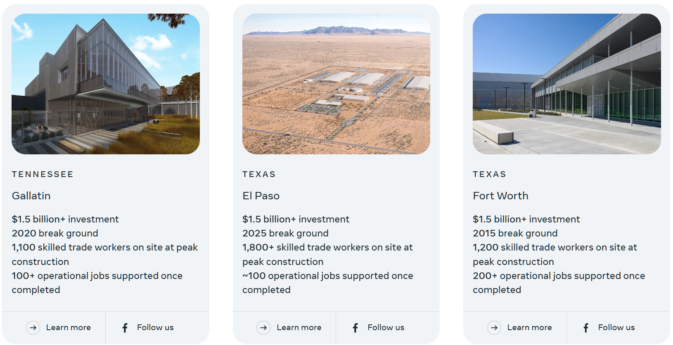
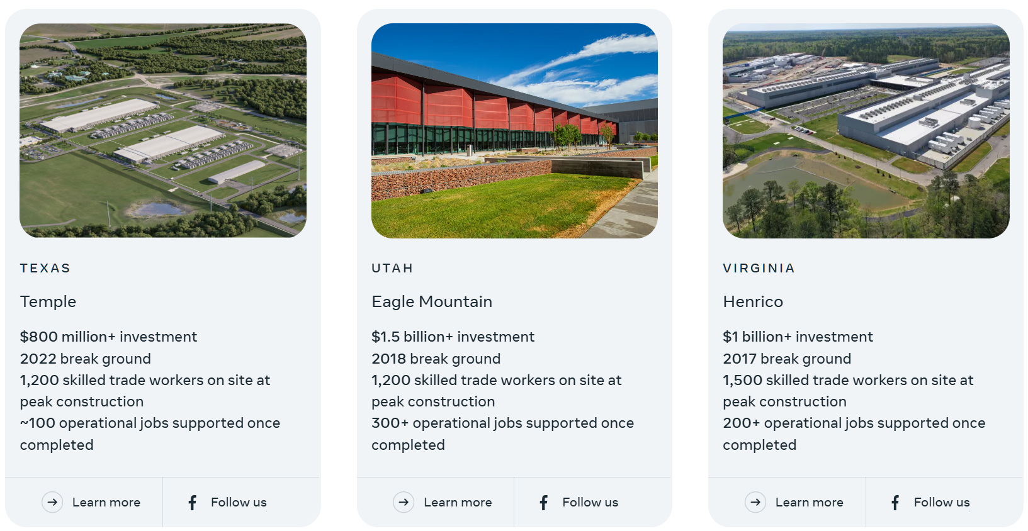
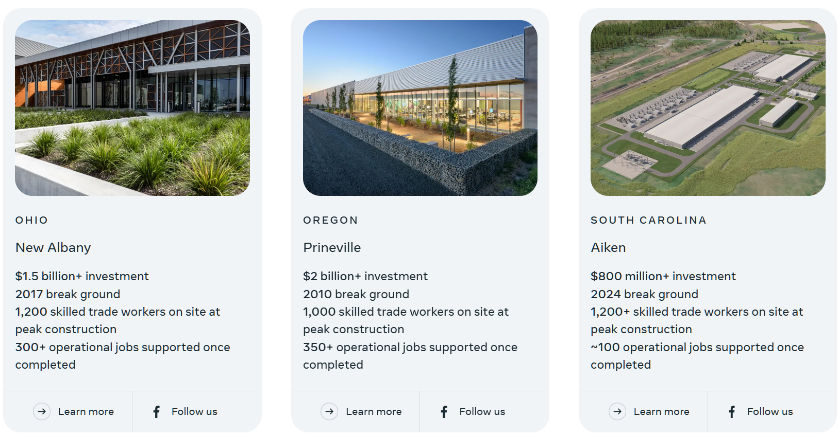
These data centers are nearly everywhere in the US
Images: Meta Data Center Locations (datacenters.atmeta.com/us-locations/)
Notes:
For companies, like Meta, these data centers are nearly everywhere across the United States.
click
There’s a very good chance that you have a data center within a few hundred miles of your home and on your local energy grid. Billions of dollars have been invested into this infrastructure, with single locations often costing an excess of $2 billion dollars.

Slide 7
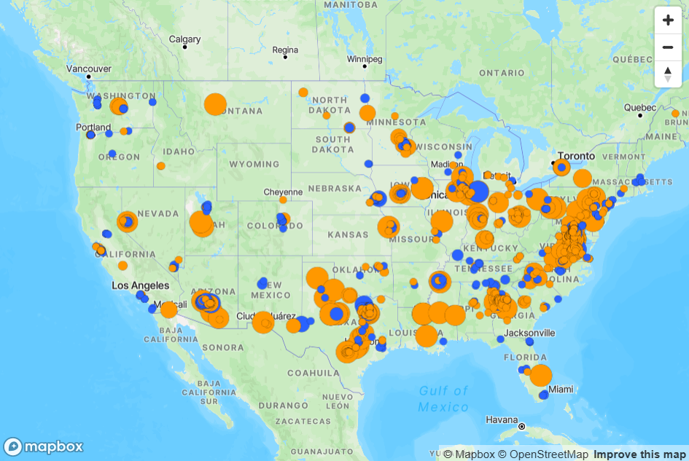

These data centers are nearly everywhere in the US
Image: Data Center Locations (https://cleanview.co/public/data-centers/us)
Notes:
Narration: Of course, Meta is not the only company with data centers, adding Google, Amazon Web Services (AWS), and other companies results in 576 currently operating data centers across the United States, as of spring 2026, with 651 more already in planning stages. You can see these projects on the map, where the blue markers indicate operating data centers and the orange markers indicating planned facilities. The size of the dot corresponding to the relative size of the data centers at that site.
Nearly all operating US Data centers primarily rely on an existing electricity grid and existing electricity generation methods. That stress on the system is causing issues with energy prices, energy reliability, and the mix of energy production methods.

Slide 8
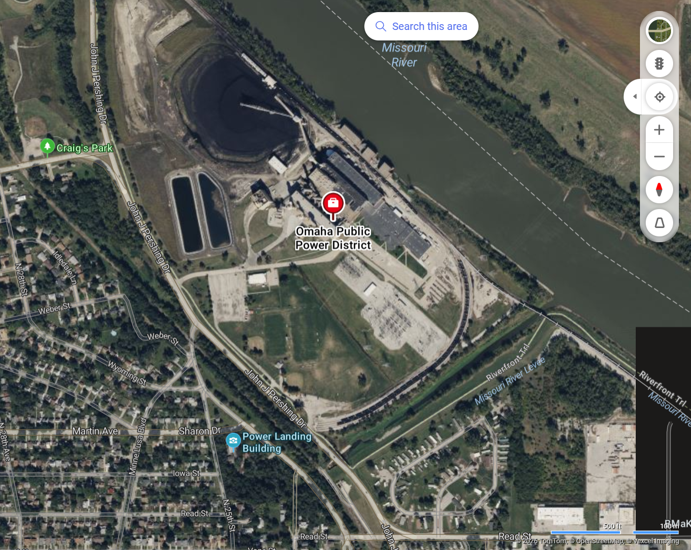
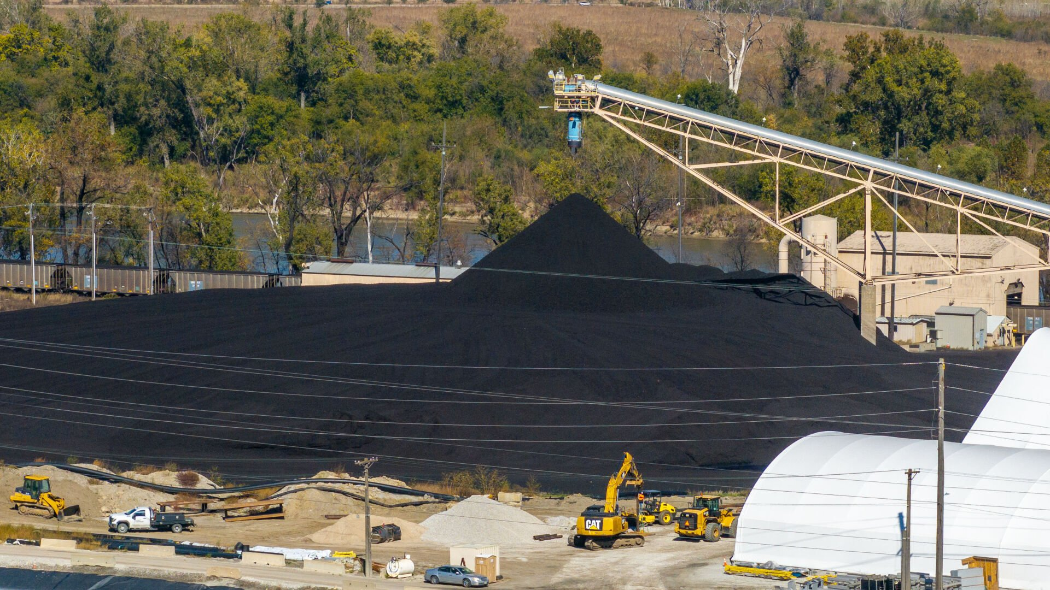

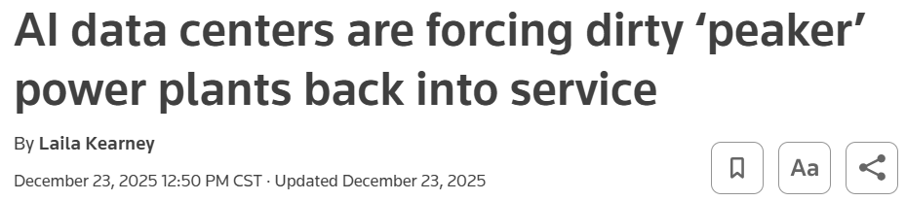
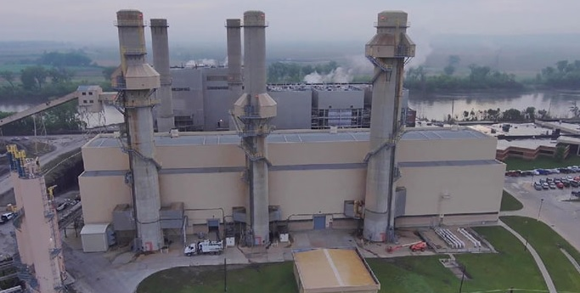
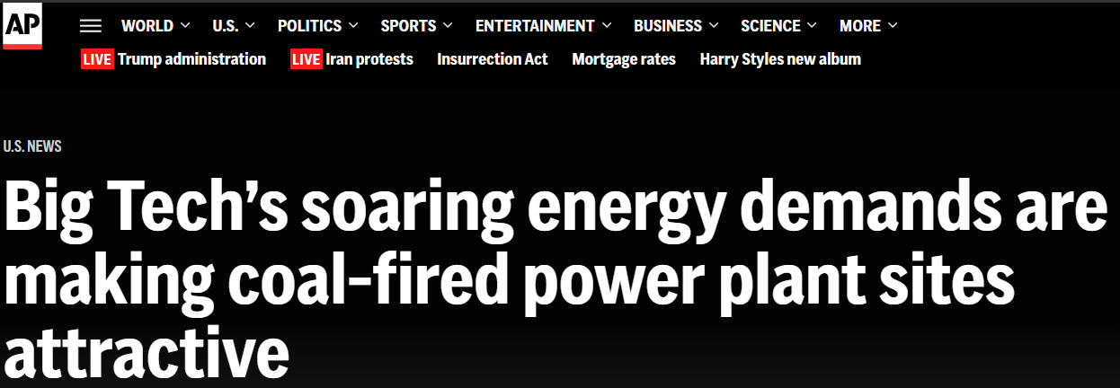
Legacy Generation Must Remain Online
Image: Coal plant photos (ketv.com)
Image: Image: Screenshot from GoogleMaps (google.com/maps)
Article: Reuters (reuters.com)
Article: AP News (apnews.com)
Notes:
Narration: With the increased stress on the local electricity grids to produce more and more energy, there is also a push to keep legacy production methods, including coal plants, online to manage this demand. In places, like Omaha, where Meta and Google have a combined 17 data centers, 60-year-old coal-powered boilers, already planned for decommission or switching over to cleaner alternatives, are forced to continue operations, despite their adjacency to neighborhoods, parks, or schools.
click
This trend is happening across the United States, where energy demands from technology are pushing local power providers to keep legacy, dirtier power plants in service, often in spite of existing plans to decommission them or only use them in high demand scenarios (called peaks).
But why do the data centers require extending the lives of these plants?
Note: So legacy production methods, including coal plants that are well beyond their life expectancy, are being forced to stay open and continue operations.
https://apnews.com/article/coal-electricity-artificial-intelligence-trump-power-energy-a3779aee7970dabded42d8d7b3ef3783

Slide 9
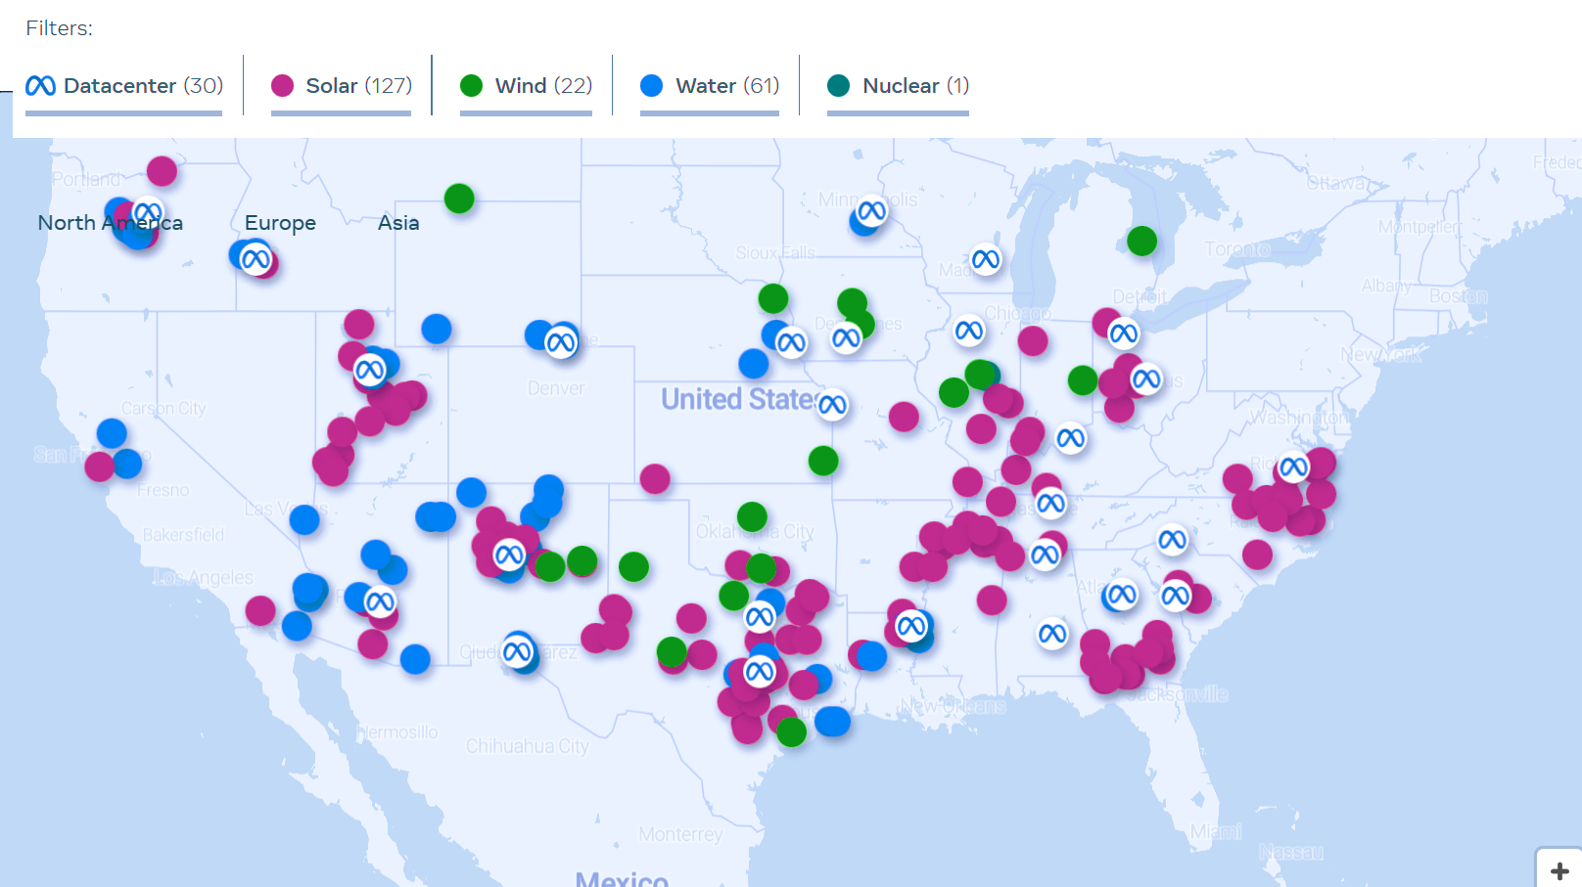
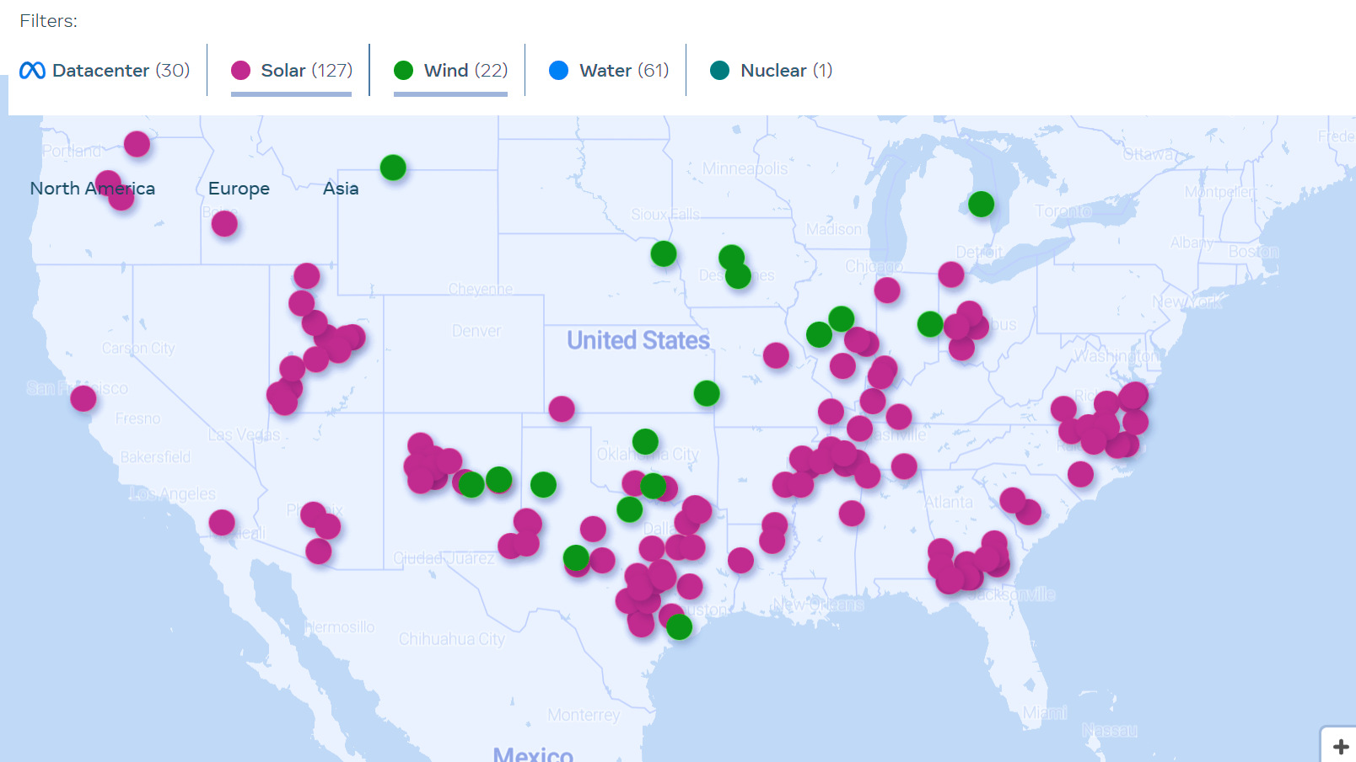
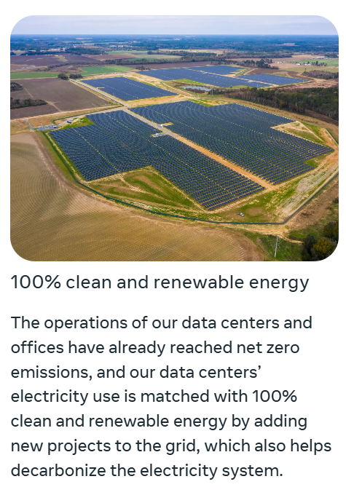
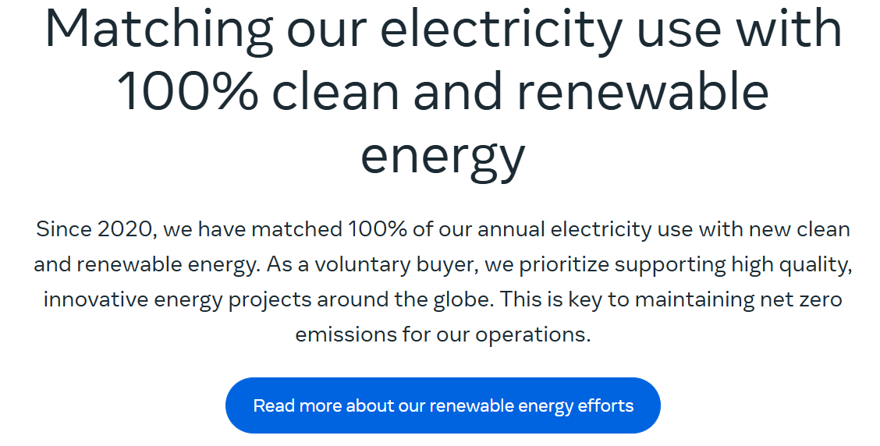

What about
100% renewable energy agreements?
Yes, but….
Images: Meta Data Center Sustainability (datacenters.atmeta.com/sustainability/)
Notes:
Narration: You might be saying to yourself, I know that many companies, like Meta, have committed to only using renewable energy for their data centers. They have solar, wind, nuclear and water projects all around the country. They certainly cannot be the reason legacy generation must continue operations.
click
This is correct. Many companies, including Meta, have made strong public claims that they will only use renewable energy, like wind and solar, for their operation. With dozens of projects across the US, this is often a step in the right direction!
click
Unfortunately, it’s not always that simple. A key word companies will often use is that they will MATCH their electricity usage on site with 100% clean and renewable energy. This isn’t the same as generating their own clean, renewable energy on-site, directly feeding the data center.
This becomes a potential issue because not all electricity generation is considered equal, and that matters for the electricity grid and its operators. The electric grid works like an air‑traffic‑control system for electricity: power plants generate energy, power lines move it across long distances, and trained grid operators oversee the whole system to keep it stable and flowing safely. Federal and regional rules set the standards these grid operators must meet to keep the whole system operating reliably.
In this presentation, I want to focus on two major reasons why matching electricity use with renewable energy poses some challenges to the electricity grid and, ultimately, forces legacy generation to continue.

Slide 10
Not all energy generation is equal
Grid Stability
Nameplate Capacity ≠ Accredited Capacity Value
Resource | Capacity Value | Why?
Gas 🔥 | High (90 – 95%) | Dispatchable anytime
Coal 🏭 | High (80 – 90%) | Runs through peak‑risk periods
Wind 🌬️ | Low (10 – 20%) | May produce 0 MW during winter peaks
Solar ☀️ | Low (20 – 40%) | Zero output at night; low in winter peaks
A data center adds a 100 MW wind farm
BUT The wind farm only counts as 10–20 MW
SO The utility still needs to provide 80–90 MW
RESULTS Only slightly less fossil-based generation
Data Table: Forecasting Resource Adequacy in Southwest Power Pool Through 2035 (ndic.nd.gov)
Data Table: Average and Marginal Capacity Credit Value (docs.nrel.gov)
Notes:
Narration: First, the electric grid operators must consider how different energy assets will affect their grid’s stability and reliability. The grid does not value all generation equally, which means that the power plant’s nameplate capacity, basically it’s theoretical output, whether from coal, natural gas, solar or wind, will not get fully counted. Grid operators establish an Accredited Capacity or Effective Load Carrying Capability to these generating assets and assigns the capacity value – basically how much they will count it for.
Solar & wind have much lower accredited capacity values than thermal units, like gas and coal. Grid operators must consider peak‑risk timing, not necessarily politics, emissions, or cost. As you might expect, coal and gas remain the backbone of capacity reliability.
Click
Let’s look at an example. A hypothetical data center is claiming their energy is matched by a wind farm. For the sake of argument, we’ll say the data center requires 100 MW of power, so they contract for a 100 MW wind farm somewhere else on the grid to match that need. The data center likely doesn’t rely on that wind farm, because they also want highly reliable energy. The grid operator will count the wind farm’s energy for providing 10-20 MW, even though it is designed for 100 MW. Yet the data center will still require that 100MW is available 24/7, often contractually. So, the utility still needs 80-90MW of baseload generation online and ready to go for them at any moment, which includes when wind and solar energy are not available. That baseload generation is nearly exclusively natural gas and/or coal-fired generation.
It gets even more challenging when you consider seasonal changes, which is the second consideration grid operators must consider.
https://www.ndic.nd.gov/sites/www/files/documents/Transmission-Authority/Publications/Other%20Studies/Forecasting-Resource-Adequacy-in-Southwest-Po-2023.pdf
https://docs.nrel.gov/docs/fy25osti/89587.pdf

Slide 11
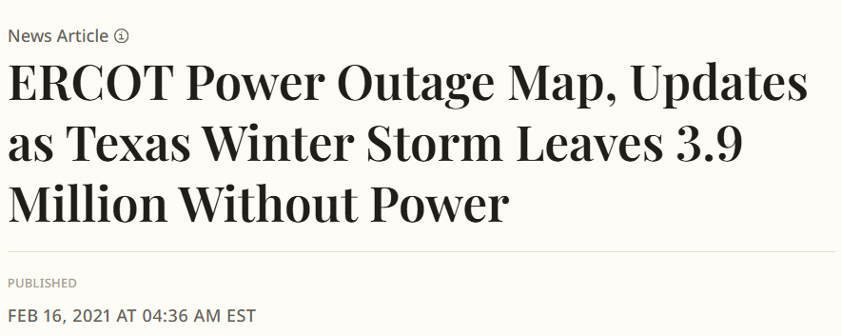
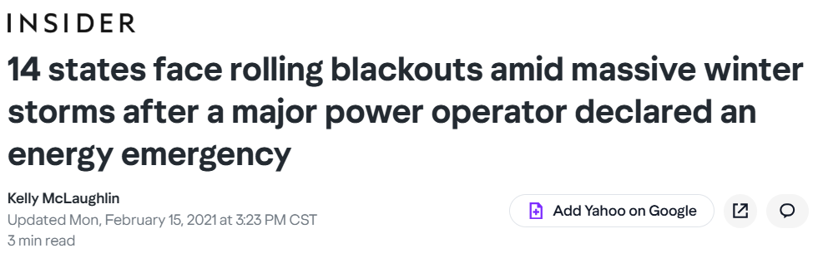
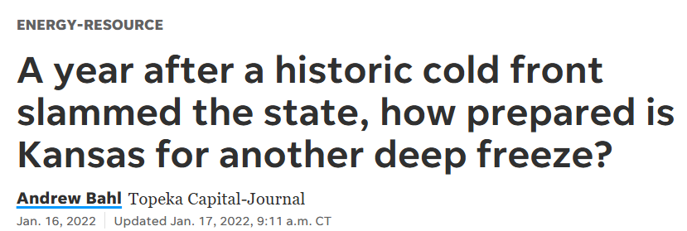
Not all energy generation is equal
Grid Stability
Summer Capacity ≠ Winter Capacity
Headline: ERCOT - Newsweek (newsweek.com)
Headline: 14 states – Business Insider (businessinsider.com)
Headline: Historic cold front – The Topeka Capital-Journal (cjonline.com)
Notes:
Narration: Over the past couple of years, it’s been decided that our generation capacity for summer is not the same as our capacity for winter.
After major winter storms hit Texas and the Midwest, including deaths and weeks-long outages, the grid operator made some new, additional requirements to better protect grid reliability and resilience.

Slide 12
Not all energy generation is equal
Grid Stability
Summer Capacity ≠ Winter Capacity
Season | Winter Planning Reserve Margins
Winter 2025-26 | 15%
Winter 2026-27 | 36%
Winter 2029-30 | 38%
Planning Reserve Margins are EXTRA capacity
(above peak demand) that a grid operator requires a utility to have available – even during extreme weather conditions.
Data Table: Southwest Power Pool News, Aug 6, 2024 (spp.org)
Notes:
Narration: With reliability issues getting more significant in the winter, the grid operators put in new planning reserve margins. These margins are extra capacity (above anticipated peak demand) that a grid operator requires a utility to have available, even during extreme weather conditions, during the winter months.
This new planning reserve margin puts additional strain on assets that have a higher capacity factor in the winter – like gas and coal – minimizing the capacity of the wind and solar assets assigned to the data centers. As you can see, these margins went up by 15% this past year and will go up to 36% into the next year and get all the way to 38% by 2030. This information is for the Southwest Power Pool throughout the Midwest, but similar values are being seen across the country. Power providers must now show that they can produce this additional capacity during the winter months, when solar and wind are typically at their lowest generation.
For this reason, data centers are often adding renewable energy into the region but their need for year-round power forces utilities to keep running legacy plants that rely on fossil-fuels.
SPP board approves new planning reserve margins to protect against high winter, summer use - Southwest Power Pool

Slide 13
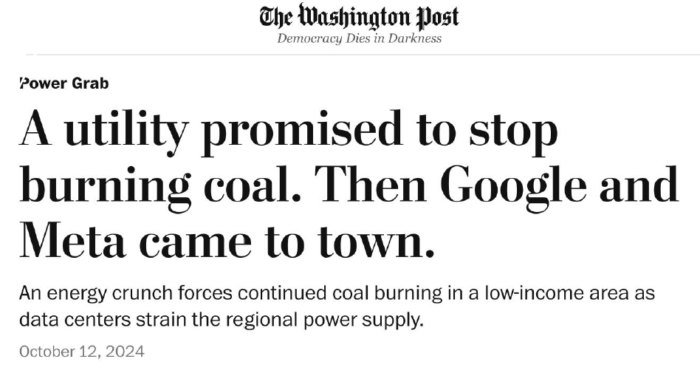
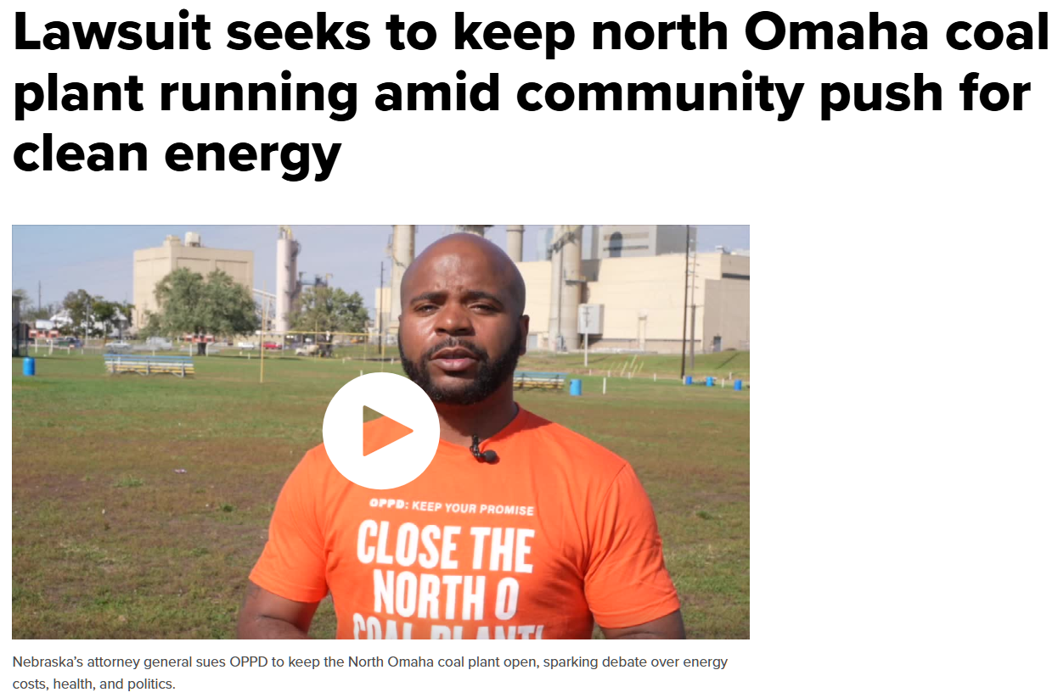
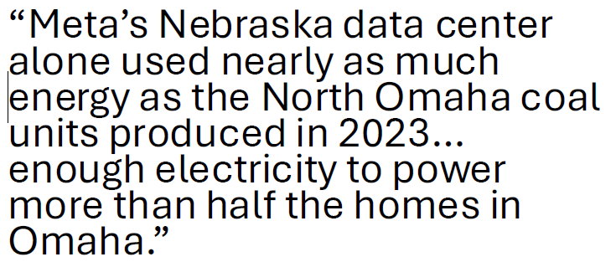
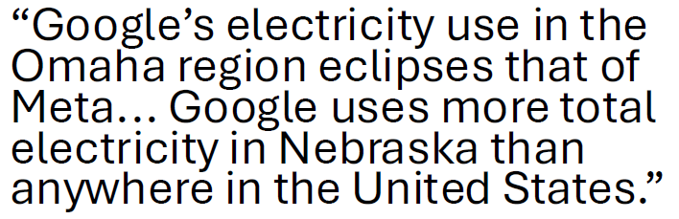
Headline: The Washington Post (washingtonpost.com)
Headline: KMTV News (3newsnow.com)
Notes:
Narration: This combination of factors has led to several communities having to keep legacy generation online, even while adding newer, cleaner generating assets to their energy production portfolio.
Take, as an example, Omaha, Nebraska. They have recently added 17 data centers from Meta and Google alone in the vicinity, along with a few other smaller companies. In 2014, the Omaha Public Power District, the local electric utility, promised to shut down the coal generating plants by 2023. These 60-year-old coal fired units are located in the middle of a predominantly black neighborhood due to historical redlining in the city. In fact, pollution from that plant is estimated by the EPA to cause 120 asthma attacks, 11 heart attacks, and 18 excess deaths each year.
However, when Meta and Google announced their arrival in the Omaha area, the utility delayed the retirement of coal generation. In a Washington Post article on this delay, reporters identified that Meta’s data centers alone used as much energy as the coal plant produces, which is enough energy to power half of the homes in Omaha. Furthermore, it’s known that Google’s electricity needs far exceed Meta’s in the same region.
These delays in stopping the burning of coal continue as the result of lawsuits and bills in the state legislature requiring that the coal plants continue operating, despite significant public pushback.
https://www.washingtonpost.com/business/2024/10/08/google-meta-omaha-data-centers/
https://www.3newsnow.com/north-omaha/lawsuit-seeks-to-keep-north-omaha-coal-plant-running-amid-community-push-for-clean-energy

Slide 14
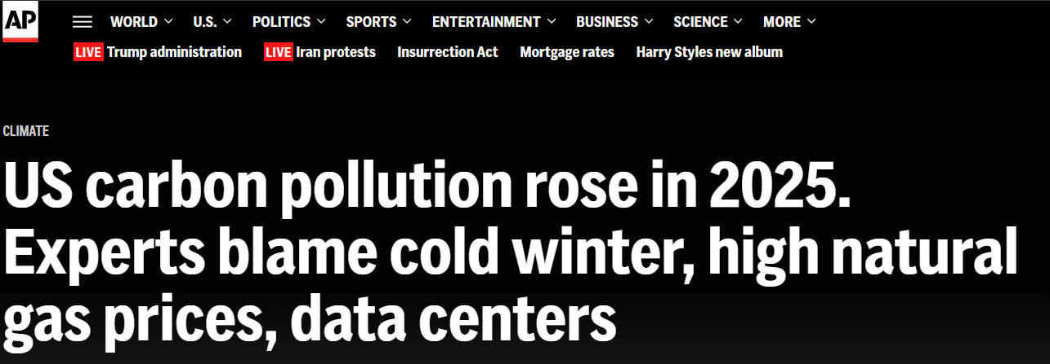
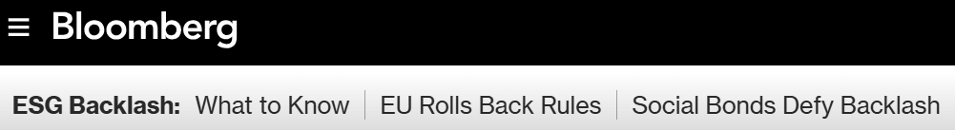
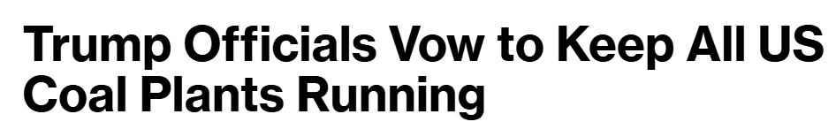
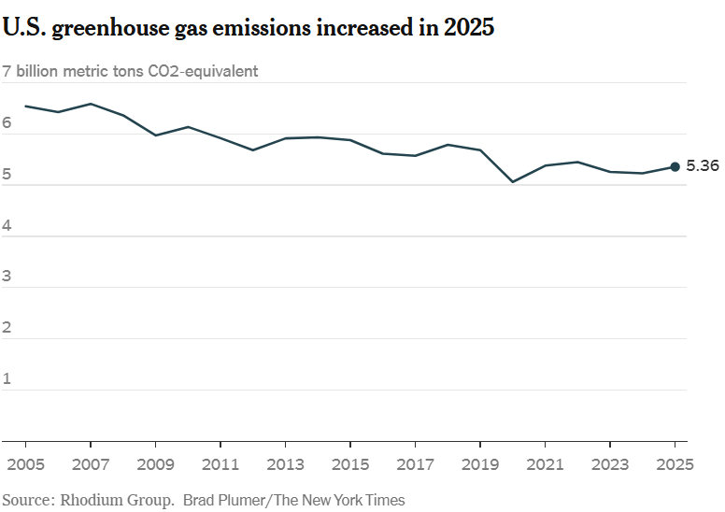
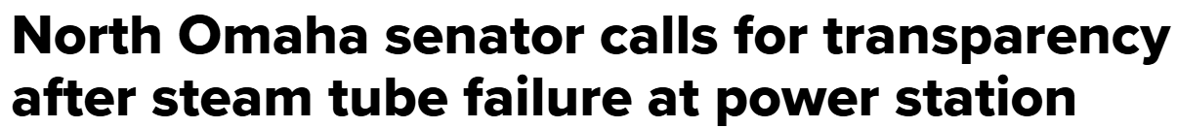
“It’s a high concern because as everyone knows those coal units are very old and at the end of their life cycle.”
Terrell McKinney, NE State Senator
Graph: The New York Times (nytimes.com)
Headline: US Carbon Pollution, AP News, Jan 13, 2026 (apnews.com)
Quote: KMTV News (3newsnow.com)
Headline: Trump Officials, Jan 15, 2026 (bloomberg.com)
Notes:
Narrative: Although Omaha is one illustrative example, this trend is happening nationally, with the federal government vowing to keep all US Coal plants running. This move has stopped at least five coal power plants from fulfilling their scheduled retirements, including one that is not actively running, and it is raising concerns over US emissions, which rose for the first time since the Covid dip. It also calls into question extending the life of legacy generation assets that are well beyond their lifespan. Many are showing signs of age through failures, expensive repairs, and long outages.
All of this leads to a wicked problem, where the economic factors are in competition with the social and environmental concerns.
https://apnews.com/article/carbon-pollution-trump-winter-data-centers-ai-680bbad6bab9a9e98421a48cb929d389
https://www.nytimes.com/2026/01/13/climate/us-emissions-2025-coal-power.html
https://www.3newsnow.com/north-omaha/north-omaha-senator-calls-for-transparency-after-steam-tube-failure-at-power-station
https://www.bloomberg.com/news/articles/2026-01-15/trump-officials-vow-to-keep-all-us-coal-plants-running

Slide 15
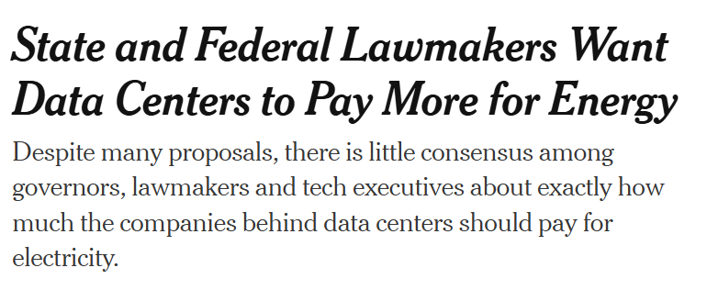

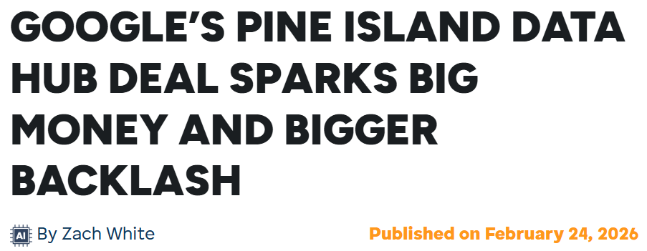

Headline: The New York Times (nytimes.com)
Headline: hoodline (hoodline.com)
Quote: KMTV News (3newsnow.com)
Headline: Trump Officials, Jan 15, 2026 (bloomberg.com)
Notes:
Narrative: This leads to a real tension being played out in real time. We’ll take economics and social first.
On one side, the public is demanding that data centers start to pay more for their energy to compensate for the need to build up infrastructure or keep legacy infrastructure online. In Rochester, Minnesota, for example, Google, Xcel Energy, and Form Energy created a clean‑energy‑powered, ratepayer‑protected, economically beneficial data‑center plan – called the Pine Island Data Hub. They have the goal of adding 1.9 gigawatts of new clean capacity while also ensuring that Xcel energy customers don’t see increased rates.
Why is this not perfect and why is their backlash? Although it does more meaningfully promote renewables and battery technology over previous data center projects, there remain significant environmental concerns for a project of this size.
https://www.nytimes.com/2026/01/15/business/energy-environment/data-center-energy-electricity-costs.html
https://hoodline.com/2026/02/google-s-pine-island-data-hub-deal-sparks-big-money-and-bigger-backlash/

Slide 16
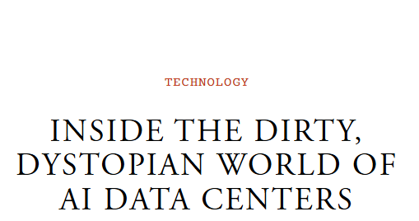

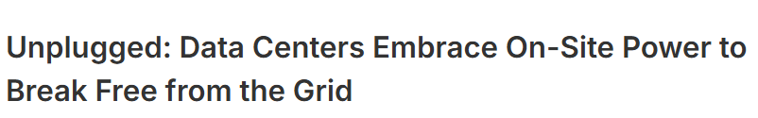

Advocate to Elected Officials
Headline: The New York Times (nytimes.com)
Headline: hoodline (hoodline.com)
Headline: The Atlantic (theatlantic.com)
Headline: Data Center Knowledge (datacenterknowledge.com)
Notes:
Narrative: Furthermore, some companies are moving away from using grid energy. Data center operators, especially hyperscalers that operate a vast network of data centers and provide the backbone of AI and the internet, are getting a realization that the amount of power they need may not even be available on the grid. In addition, grid interconnection timelines are very slow (often 3 – 7 years out). For this reason, companies, like xAI, have rapidly deployed behind-the-meter projects like mobile gas generators to power their data-center sites.
This can support some of the economic challenges, but it often exacerbates the social and environmental concerns, where the public gets little say on the operation of these assets.
These often dirty and loud solutions have caused a lot of controversy, but it is becoming an increasingly common development strategy.
Often, the public must step in to sway policy on how these data centers get their energy, which can have a major impact on the potential emissions, noise and environmental justice concerns. For example, there are some renewables and behind-the-meter grid alternatives, such as fuel cells, that are gaining traction as a cost-effective and time-saving solution.
Advocating your cares and concerns on this issue to elected officials is critical right now, as the policies are being written at the local, state and national levels. In particular, early action, when zoning and planning is taking place, is critical.
https://www.nytimes.com/2026/01/15/business/energy-environment/data-center-energy-electricity-costs.html
https://hoodline.com/2026/02/google-s-pine-island-data-hub-deal-sparks-big-money-and-bigger-backlash/
https://www.theatlantic.com/magazine/2026/04/ai-data-centers-energy-demands/686064/
https://www.datacenterknowledge.com/energy-power-supply/report-more-data-centers-will-unplug-from-grid

Slide 17
Sustainability’s
Wicked Problem
AI and Data Centers
Notes:
Narration: We hope that you have a slightly broader understanding of this wicked problem in sustainability, where the interconnected challenges are very real and very complex.
Image: https://nebraskaexaminer.com/2022/07/28/facebook-parent-company-meta-continues-growth-in-nebraskas-sarpy-county/

Slide 18
References

Slide 19
References
Reports & Technical Sources
  Vivan Lee, Pattabi Seshadri, Clark O’Neil, Archit Choudhary, Braden Holstege, and Stefan Deutcher (2025). Boston Consulting Group. Breaking Barriers to Data Center Grown. https://www.bcg.com/publications/2025/breaking-barriers-data-center-growth
  Southwest Power Pool (2024). SPP board approves new planning reserve margins to protect against high winter, summer use. https://www.spp.org/news-list/spp-board-approves-new-planning-reserve-margins-to-protect-against-high-winter-summer-use/
  Isaac Orr, Mitch Rolling, and Brent Bennet, North Dakota Transmission Authority (2023). Forecasting Resource Adequacy in Southwest Power Pool Through 2035. https://www.ndic.nd.gov/sites/www/files/documents/Transmission-Authority/Publications/Other%20Studies/Forecasting-Resource-Adequacy-in-Southwest-Po-2023.pdf
  Bloom Energy (2025). Onsite Generation Expected to Fully Power 27% of Data Center Facilities by 2030. https://www.bloomenergy.com/news/onsite-generation-expected-to-fully-power-27-percent-of-data-center-facilities-by-2030/
  Drew Robb (2025). Data Centers Bypassing the Grid to Obtain the Power They Need. https://www.datacenterknowledge.com/energy-power-supply/data-centers-bypassing-the-grid-to-obtain-the-power-they-need
  James Walker (2025). Data Centers to Drive Surging Global Power Demand – IEA. https://www.datacenterknowledge.com/energy-power-supply/data-centers-to-drive-surging-global-power-demand-iea
  Michael Thomas (2026). Data Centers in the US. https://cleanview.co/public/data-centers/us
  An Pham, Wesley Cole, Pieter Gagnon (2025). Average and Marginal Capacity Credit Values of Renewable Energy and Battery Storage in the United States Power System. https://docs.nrel.gov/docs/fy25osti/89587.pdf

Slide 20
References
News Articles
  Cind Gonzales (2022). Facebook parent company, Meta, continues growth in Nebraska’s Sarpy County. https://nebraskaexaminer.com/2022/07/28/facebook-parent-company-meta-continues-growth-in-nebraskas-sarpy-county/
  Seren Morris (2021). ERCOT Power Outage Map, Updates as Texas Winter Storm Leaves 3.9 Million Without Power. https://www.newsweek.com/ercot-power-outage-map-updates-texas-winter-storm-1569498
  Andrew Bahl (2022). A year after a historic cold front slammed the state, how prepared is Kansas for another deep freeze? https://www.cjonline.com/story/business/energy-resource/2022/01/16/kansas-lawmakers-want-prevent-repeat-after-rolling-blackouts-winter-storm/9172177002
  Kelly McLaughlin (2021). 14 states face rolling blackouts amid massive winter storms after a major power operator declared an energy emergency. https://www.yahoo.com/news/14-states-face-rolling-blackouts-212352798.html
  Mark Levy (2025). Big Tech’s soaring energy demands are making coal-fired power plant sites attractive. https://apnews.com/article/coal-electricity-artificial-intelligence-trump-power-energy-a3779aee7970dabded42d8d7b3ef3783
  Laila Kearney (2025). AI data centers are forcing dirty ‘peaker’ power plants back into service. https://www.reuters.com/business/energy/ai-data-centers-are-forcing-obsolete-peaker-power-plants-back-into-service-2025-12-23/
  Eval Halper (2024). A utility promised to stop burning coal. Then Google and Meta came to town. https://www.washingtonpost.com/business/2024/10/08/google-meta-omaha-data-centers/
  KMTV News Now (2025). Lawsuit seeks to keep north Omaha coal plant running amid community push for clean energy. https://www.3newsnow.com/north-omaha/lawsuit-seeks-to-keep-north-omaha-coal-plant-running-amid-community-push-for-clean-energy

Slide 21
References
News Articles
  Seth Borenstein (2026). US carbon pollution rose in 2025. Experts blame cold winter, high natural gas prices, data centers. https://apnews.com/article/carbon-pollution-trump-winter-data-centers-ai-680bbad6bab9a9e98421a48cb929d389
  Brad Plummer (2026). U.S. Emissions Jumped in 2025 as Coal Power Rebounded. https://www.nytimes.com/2026/01/13/climate/us-emissions-2025-coal-power.html
  KMTV News Now (2026). North Omaha senator calls for transparency after steam tube failure at power station. https://www.3newsnow.com/north-omaha/north-omaha-senator-calls-for-transparency-after-steam-tube-failure-at-power-station
  Jennifer Dlouhy and Will Wade (2026). Trump officials vow to keep all US coal plants running. https://www.bloomberg.com/news/articles/2026-01-15/trump-officials-vow-to-keep-all-us-coal-plants-running
  Ivan Penn and Karen Weise (2026). State and Federal Lawmakers Want Data Centers to Pay More for Energy. https://www.nytimes.com/2026/01/15/business/energy-environment/data-center-energy-electricity-costs.html
  Zach White (2026). Google’s Pine Island Data Hub Deal Sparks Big Money And Bigger Backlash. https://hoodline.com/2026/02/google-s-pine-island-data-hub-deal-sparks-big-money-and-bigger-backlash/
  Mateo Wong (2026). Inside the Dirty, Dystopian World of AI Data Centers. https://www.theatlantic.com/magazine/2026/04/ai-data-centers-energy-demands/686064/
  Shane Snider (2026). Unplugged: Data Centers Embrace On-Site Power to Break Free from the Grid. https://www.datacenterknowledge.com/energy-power-supply/report-more-data-centers-will-unplug-from-grid

Slide 22
References
Images
  Sarpy County Data Center [meta]. https://nebraskaexaminer.com/2022/07/28/facebook-parent-company-meta-continues-growth-in-nebraskas-sarpy-county/
  Screenshot from OpenAI. https://chatgpt.com/
  Screenshot from Spotify. https://open.spotify.com/
  Screenshot from TikTok. https://www.socialpilot.co/tiktok-marketing/tiktok-ads
  Smart Data Centers. https://climawellsystem.com/
  Screenshot from GoogleMaps. https://www.google.com/maps
  Screenshots from Meta Data Center Locations. https://datacenters.atmeta.com/us-locations/
  Data Centers in the United States. https://cleanview.co/public/data-centers/us
  AWS Regions and Availability Zones. Global Infrastructure. https://aws.amazon.com/about-aws/global-infrastructure/regions_az/
  Meta Data Centers: Sustainability. https://datacenters.atmeta.com/sustainability/
  OPPD Board of Directors votes to extend operations at the north Omaha station coal plant. https://www.ketv.com/article/oppd-board-of-directors-votes-to-extend-operations-coal-plants/69814800

