Slide 1
Is global warming real
and is it caused by humans?
The “Five Pillars of Climate Science”
Five basic pieces of evidence from climate science that together provide a logical argument that global warming is real and is caused by humans.

Slide 2
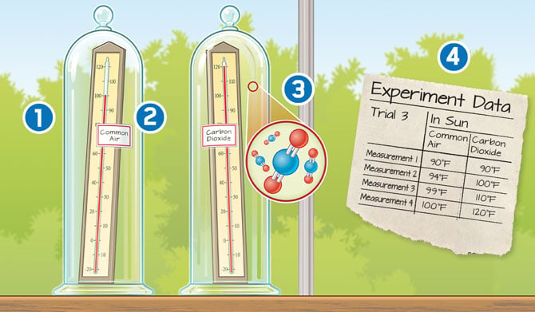
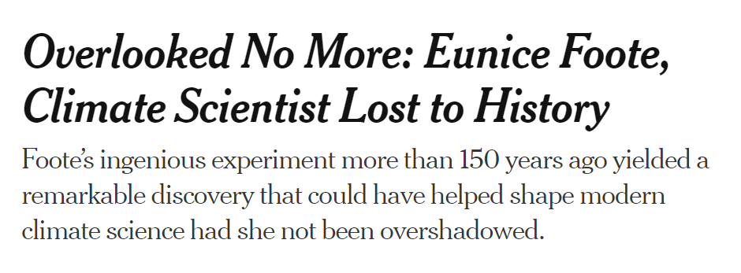


1. CO₂ is a greenhouse gas

Slide 3
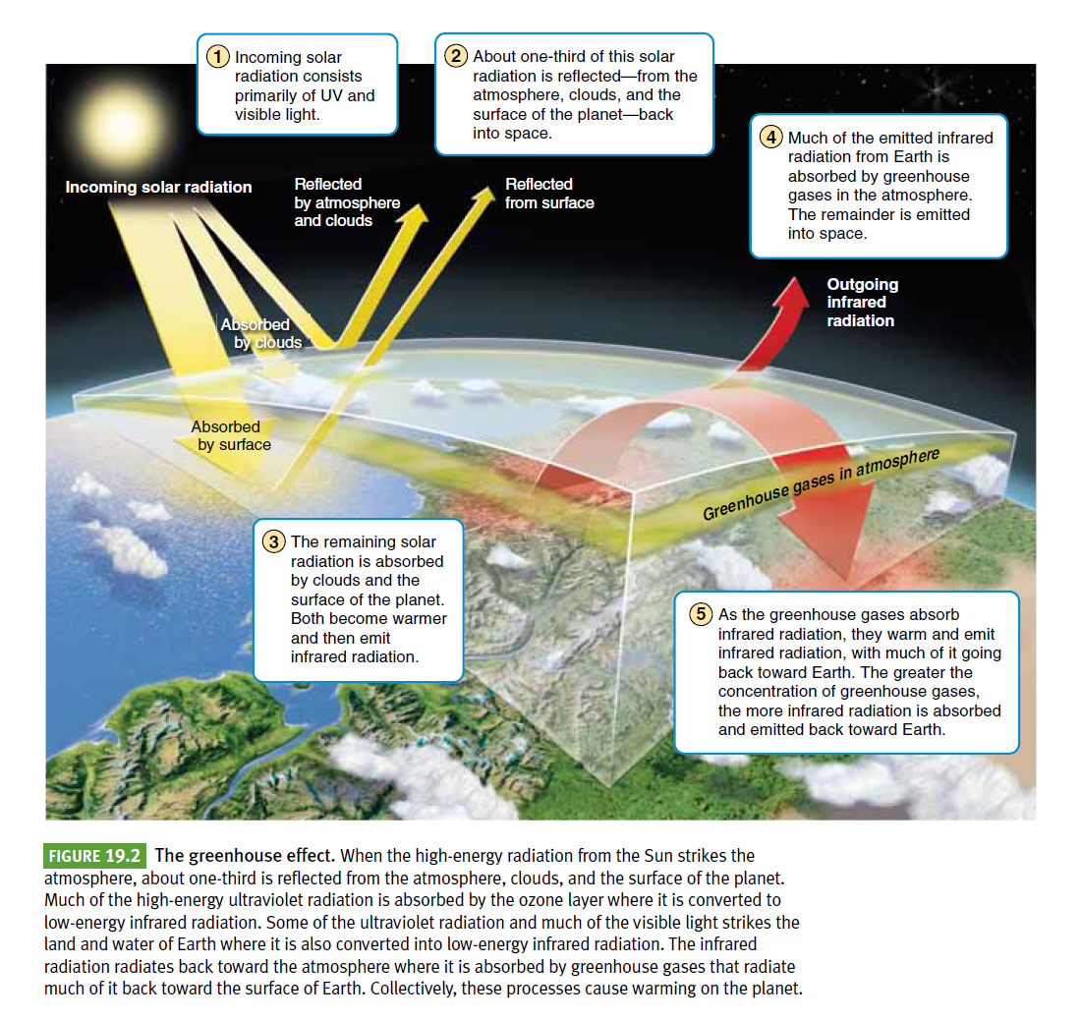
The Greenhouse Effect
Note: Climate has many causes
(multiple “forcings” and “feedbacks”) operating on multiple timescales.
The Greenhouse Effect is only one of these, but it is currently the most important.
CO₂ is not the only greenhouse gas. Methane, nitrous oxide, and others are also part of the cause of the current warming.

Slide 4
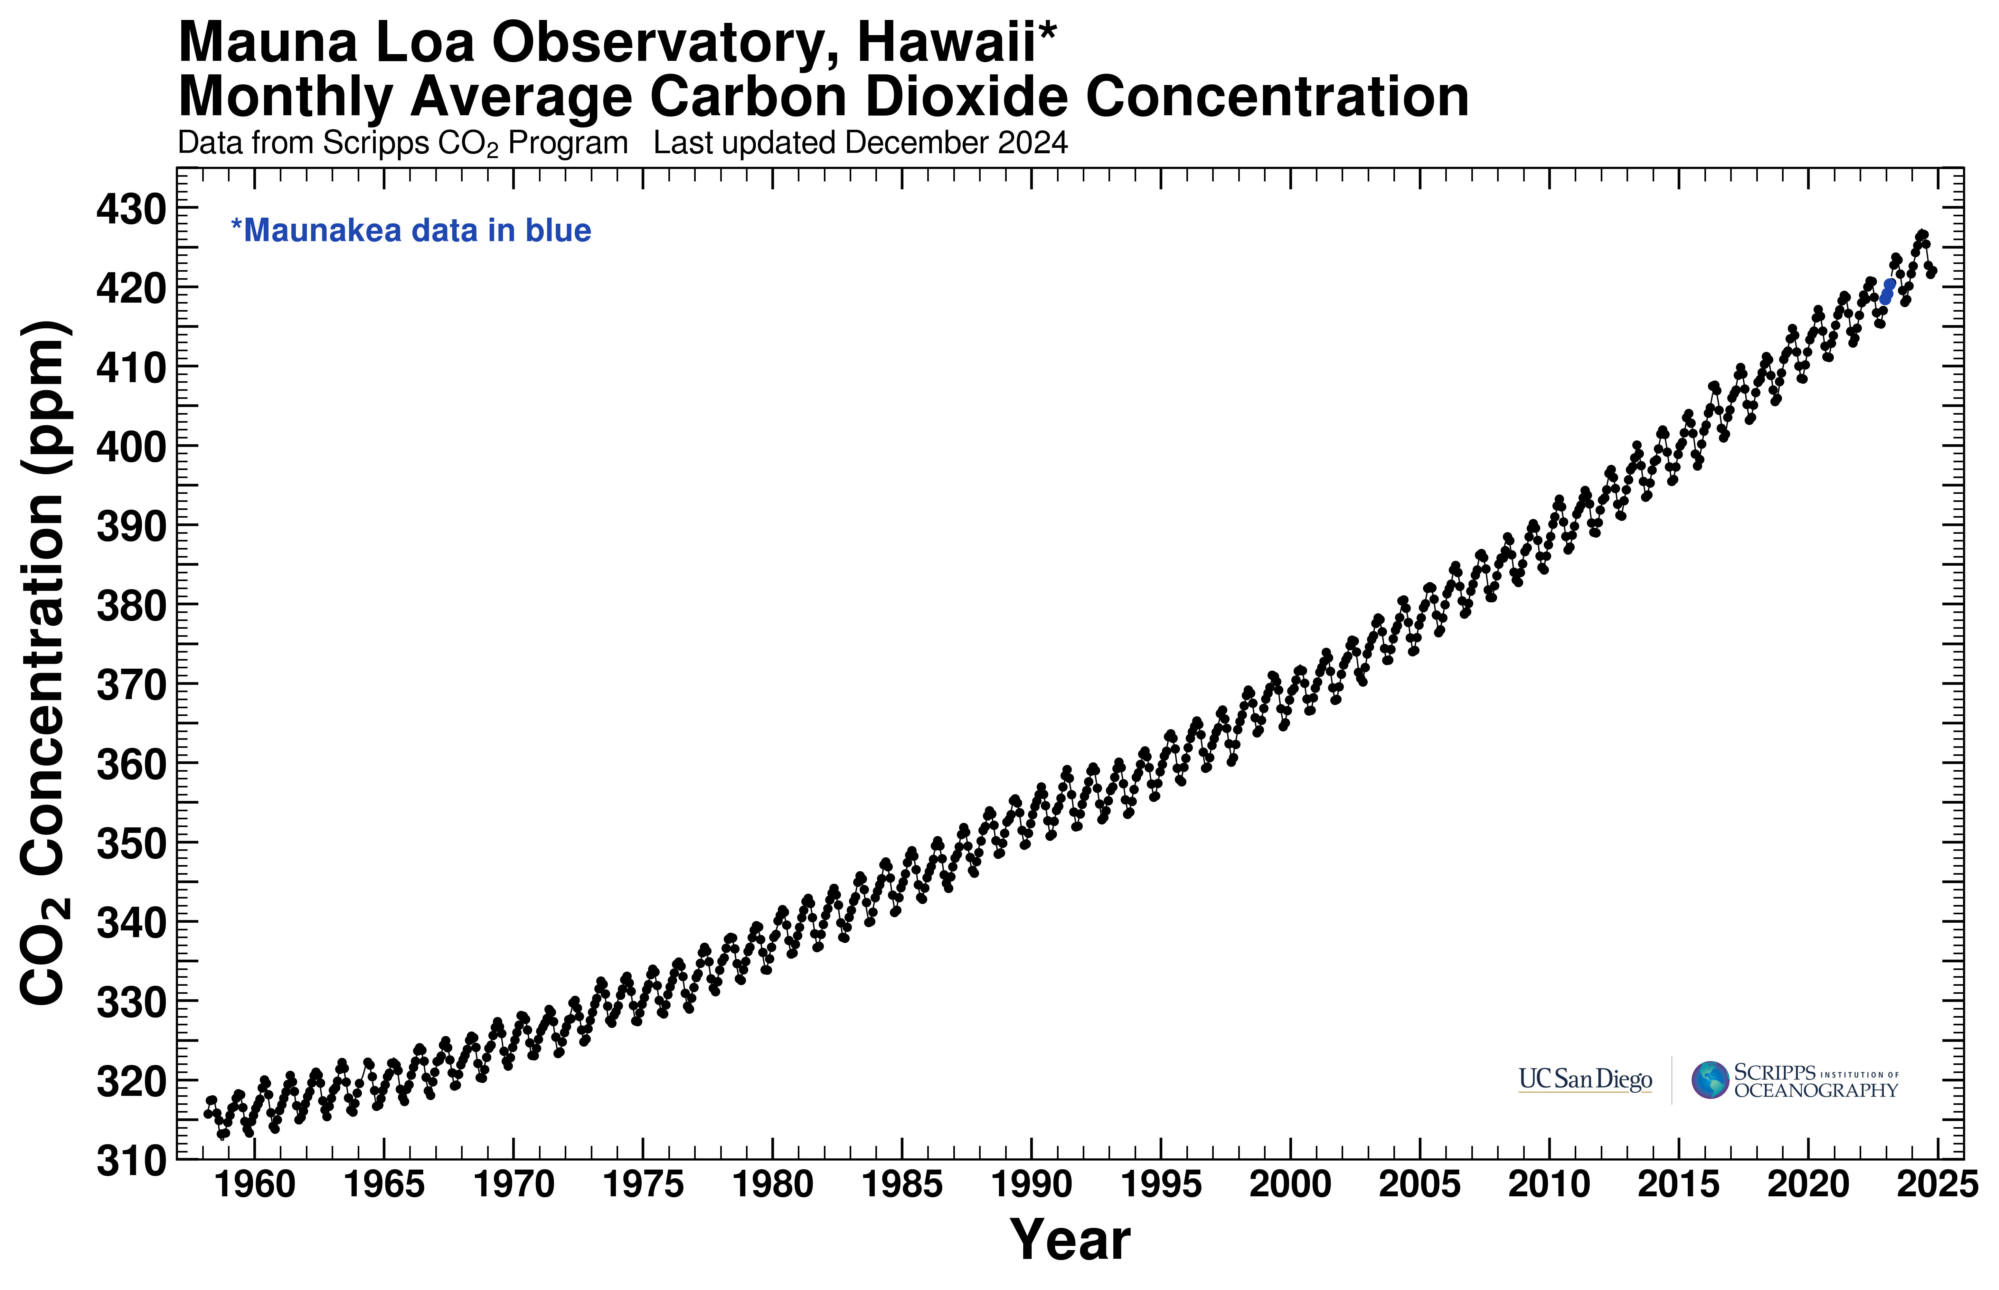
2. CO₂ is increasing in the atmosphere
Updated graph here

Slide 5
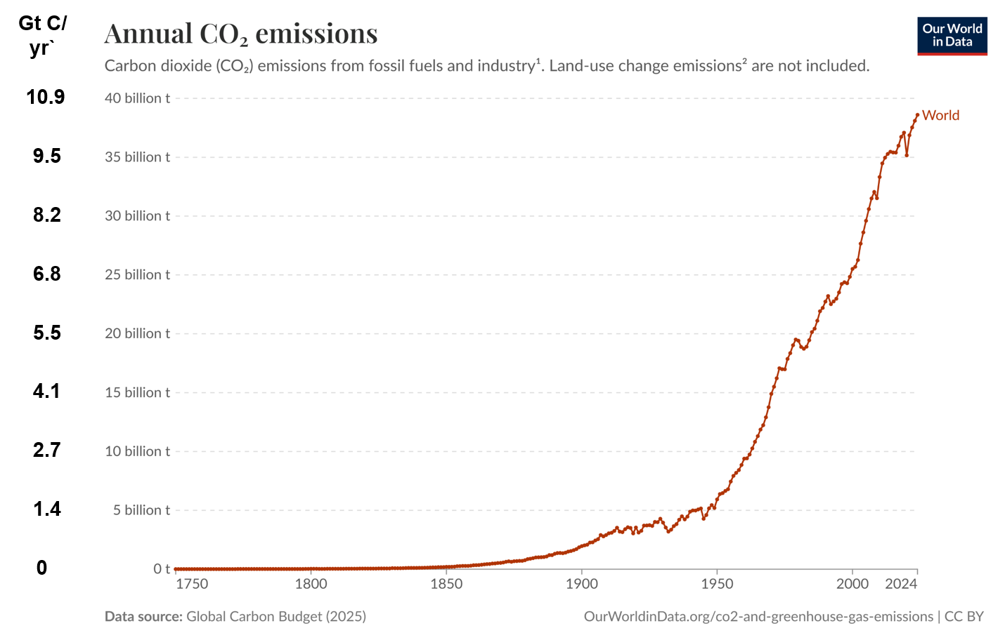
3. The increase in atmospheric CO₂ is caused by human fossil fuel burning.
Read about other evidence (eg isotopes) here

Slide 6
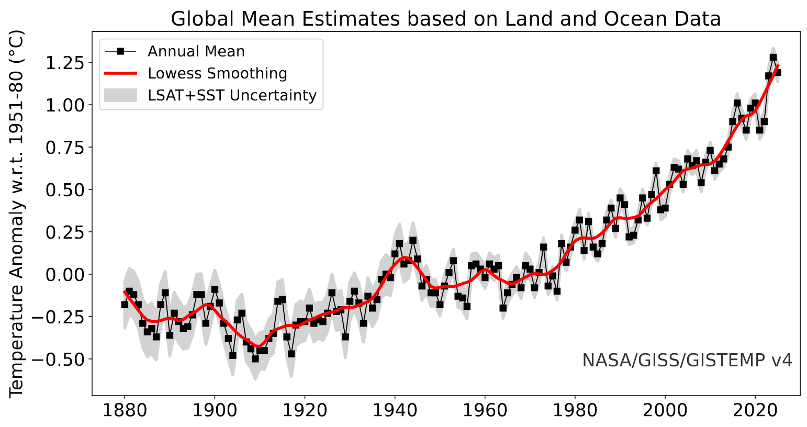
4. Global temperatures are rising
2024
1.28 C
Updated Temperature Record here

Slide 7
How do we know the increase in temperature is due to increasing greenhouse gases
and not some other factor?
Climate Forcings:
  Greenhouse gases
      CO₂
      Methane
      Nitrous Oxide
      Others
  Orientation of the earth
  Solar activity
  Aerosols & clouds
  Albedo (surface reflectance)

Slide 8
5. The increase in global temperature is overwhelmingly caused by increasing greenhouse gases, mainly CO₂.
IPCC Report, 2023 pg 43 (59 in pdf)

Slide 9
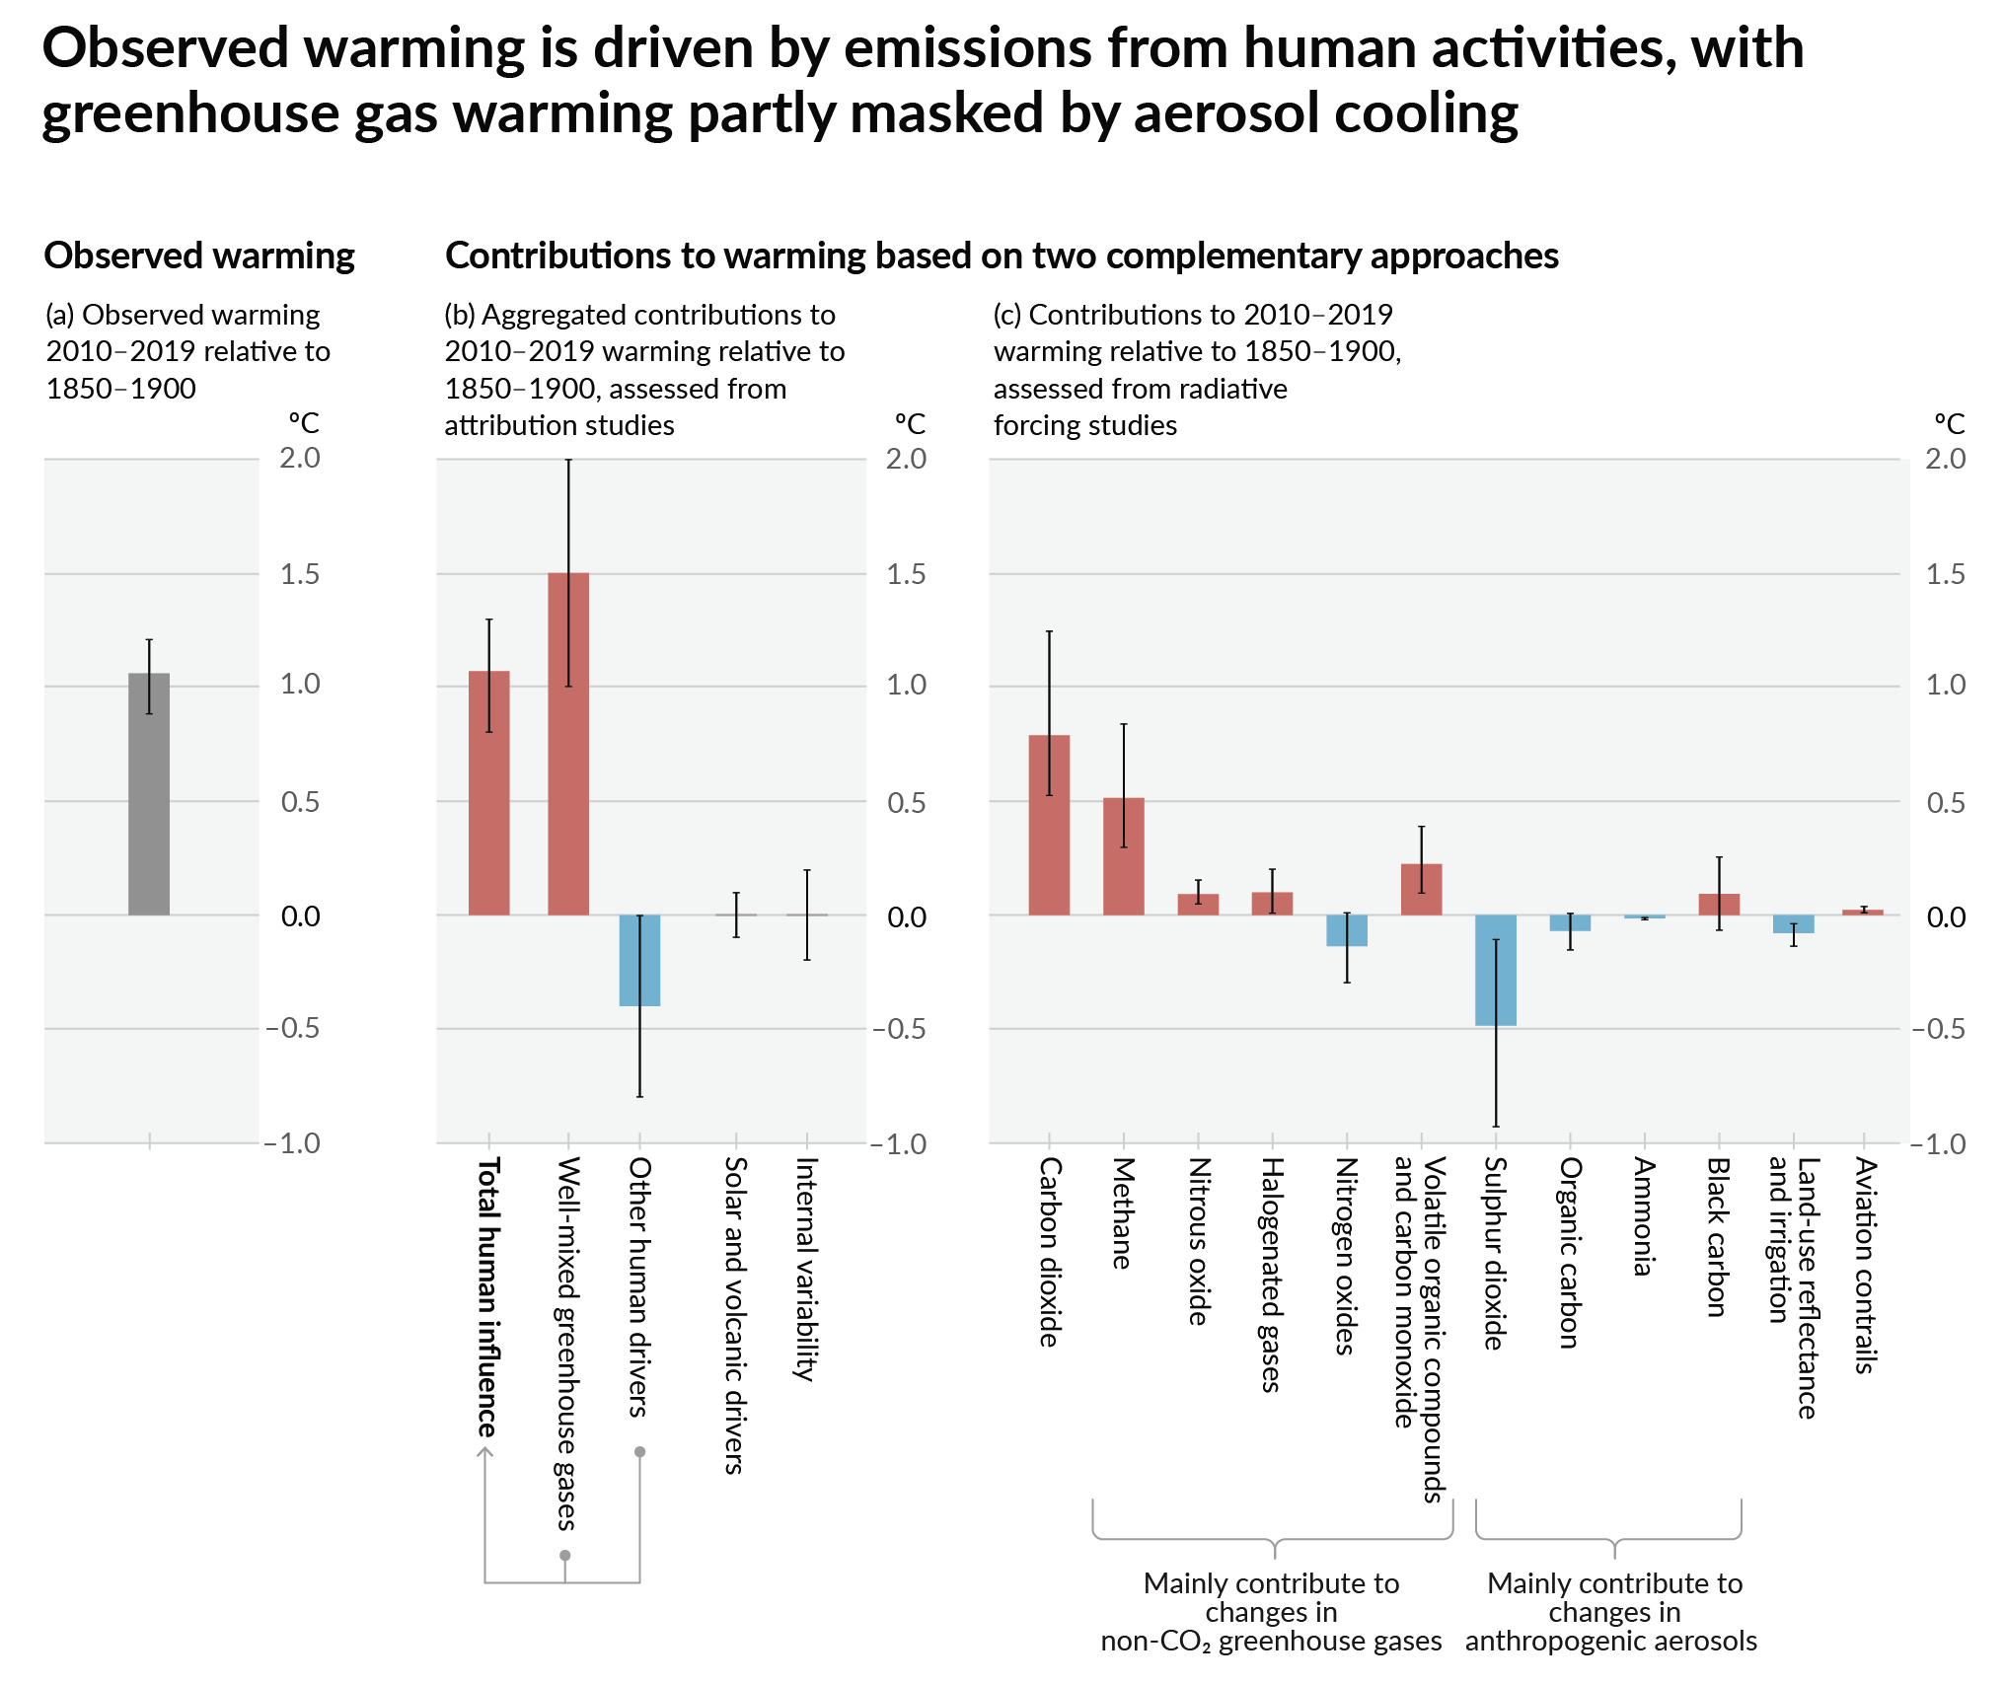
IPCC AR6, 2021 pg 7 (11 in pdf)_

Slide 10
Summary - Five pillars of Climate Science
What are the essential pieces of evidence for the scientific argument that the planet is warming and humans are responsible?
CO₂ is a greenhouse gas.
CO₂ is increasing in the atmosphere.
The increase in CO₂ is caused by human fossil fuel burning.
Global temperatures are rising.
The increase in temperatures is overwhelmingly due to human emissions in CO₂ and other greenhouse gases.
The Evidence
Discovered in 1856. No associated figure or data set.
Mauna Loa CO₂ Record (aka “The Keeling Curve”)
Emissions data; isotopes; global carbon cycle models driven by empirical observations and measurements (“sources and sinks”)
NASA temperature record
IPCC forcings model

